Slide 1


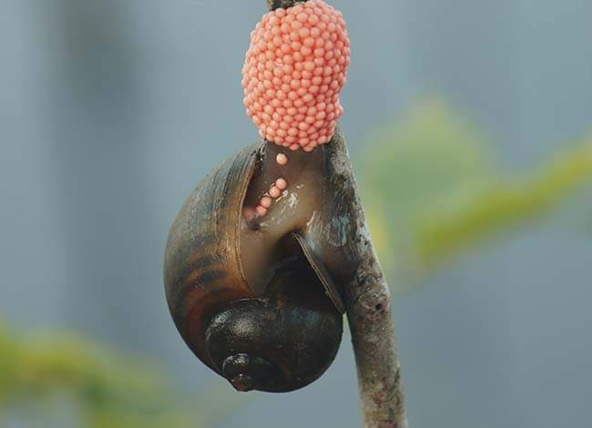
Ministry of Agriculture, Livestock
and Irrigation
Golden Apple Snail (GAS) Experiment
(2017-2018)
Khaing Thazin Winn
Assistant Staff Officer
Department of Agriculture

Slide 2
Golden Apple Snail Experimental Plot
Crops - Sinthwelat (Rice)
Experimental Design - RCB(5×4)
Village - KyoneTar
Township/District - Pyapon/Pyapon
Region - Ayeyarwady
Farmer’ s Name - U Mg Mg Thwin
Field No./Plot No. - 457A , 19/1
Small Plot Size - 20'× 20'

Slide 3
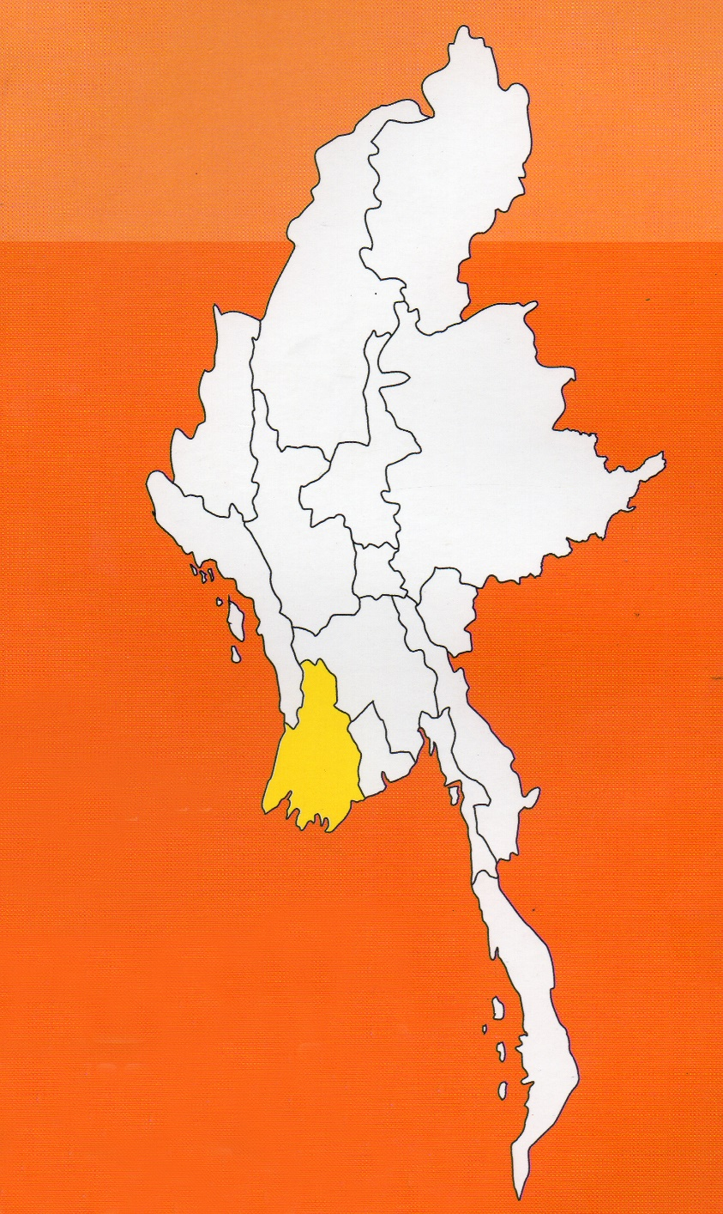
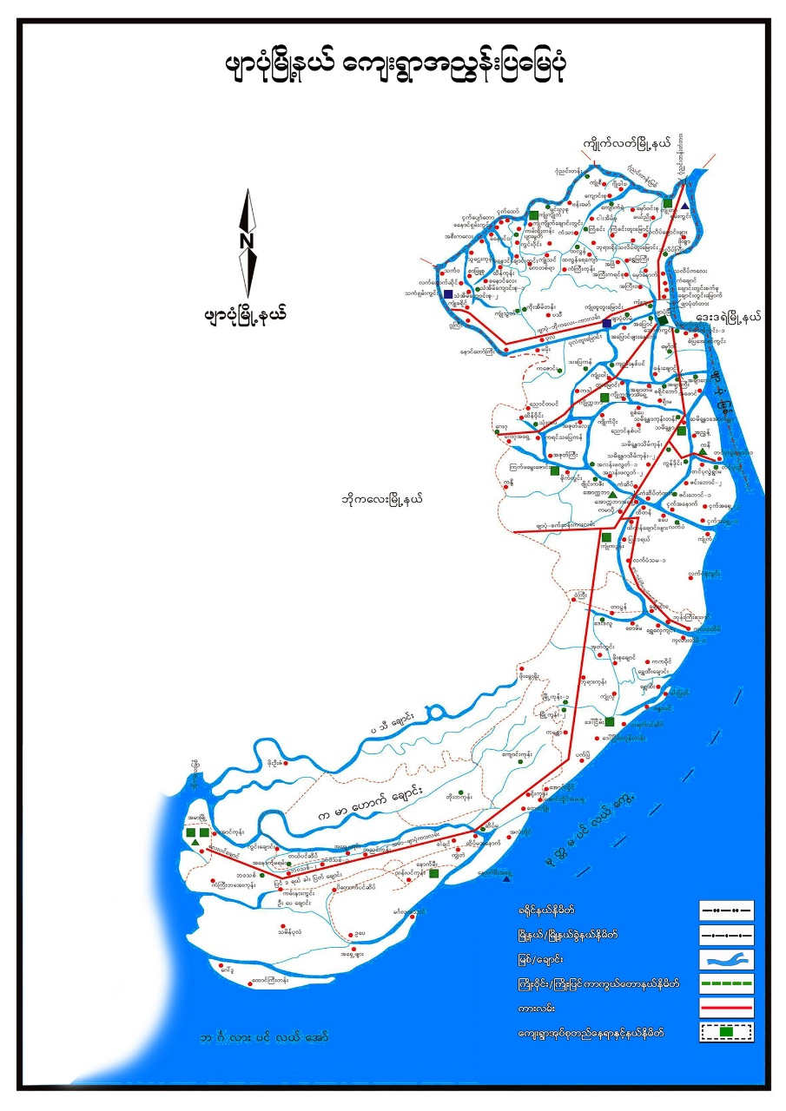
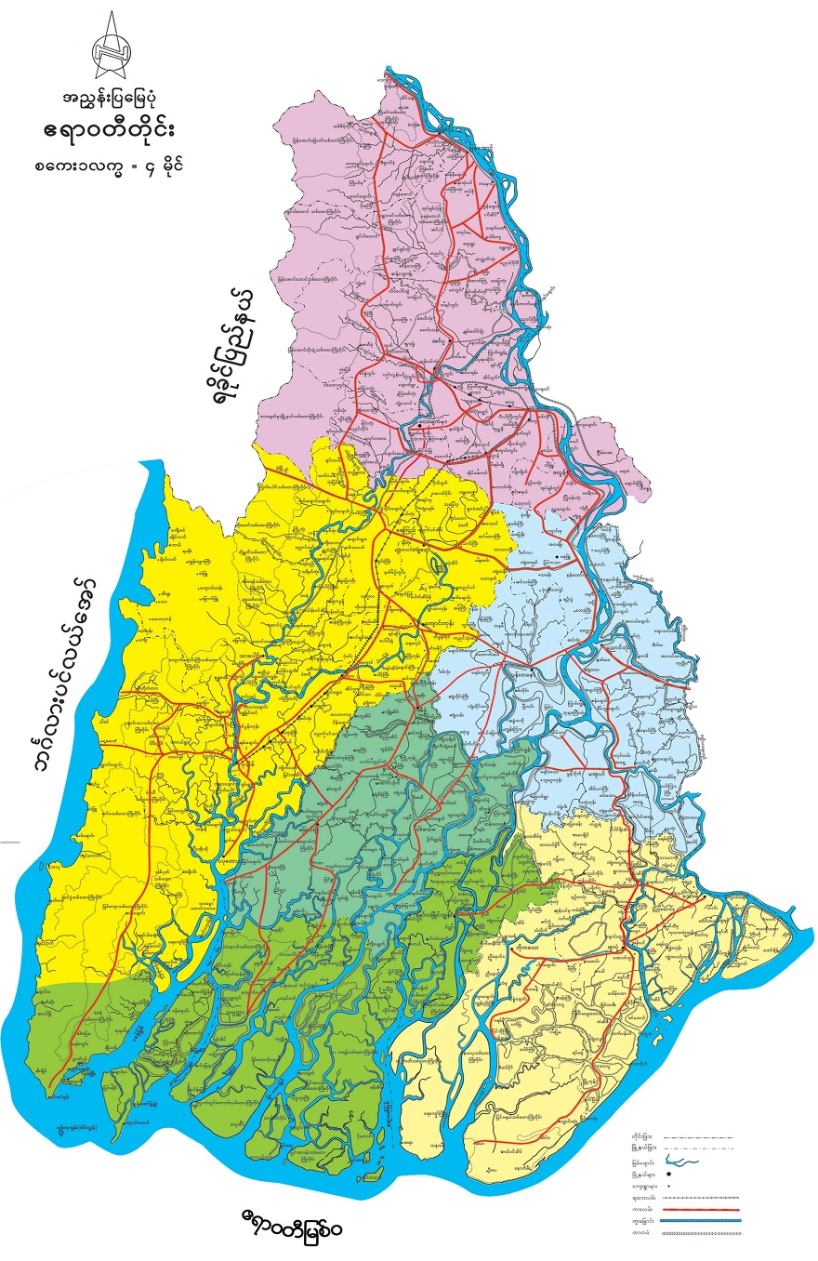
Background Data of Pyapon Township
Township - Pyapon
Area - 578.315 Sq/mile
Sowing Acre - 210612 ac
(monsoon)
Ecology - Delta Region
Rainfall - 133 days/124.14"
Temperature - 23.92 ˚C , 32.88˚ C
Altitude - 8'. 2 "
Main Crop - Paddy

Slide 4
Golden Apple Snail And Pyapon District
GAS Infestation
2011 - Dedaye Township (Tamot Village)
2013 - Dedaye Township (Mosoon Rice)
2014-2015 - Pyapon and Kyikelat Township
2016 - Bogalay Township
2017-2018 - (10) Township of Ayeyarwady Region

Slide 5
Objectives
To achieve locally adaptable treatment for GAS
To control effectively using IPM
To know and follow the GAS control measure by farmers

Slide 6
Activities of the Experimental Plot
Treatment - (5)
T₁- Hand Picking
T₂- Use of Attractant feeds
T₃- Use of Pesticide
T₄- Using raised bed (Old Seedling)
T₅- Control
Replication - (4)

Slide 7
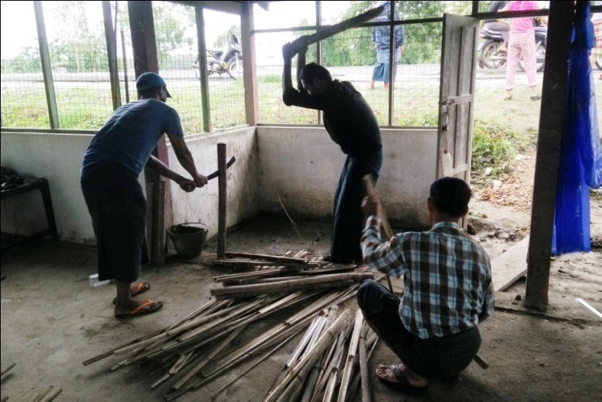
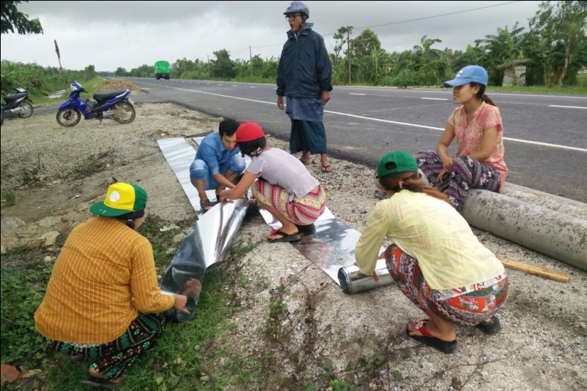
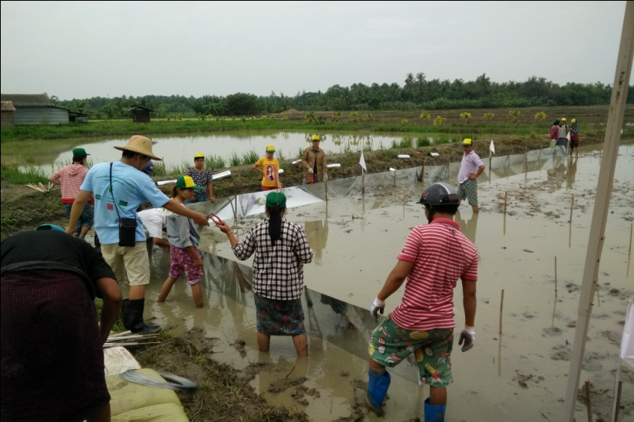
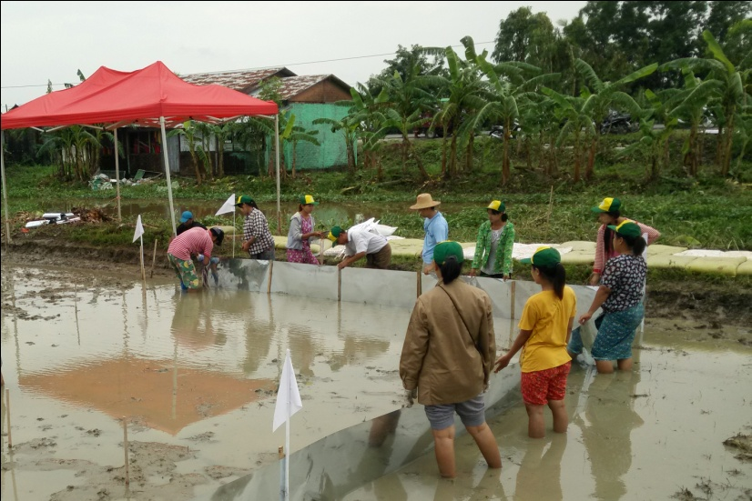
Preparation for Experiment

Slide 8
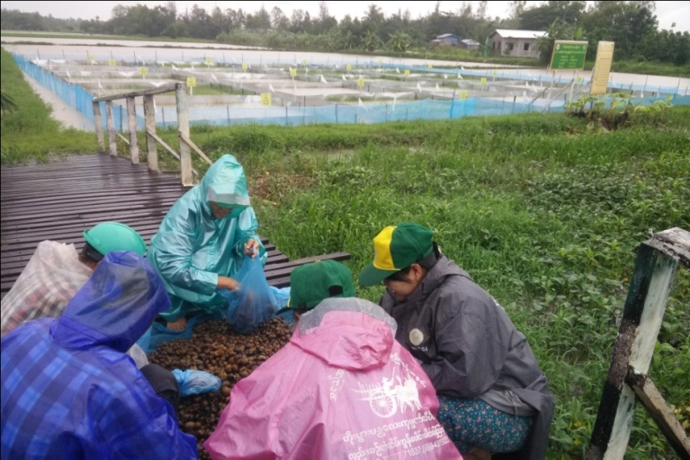
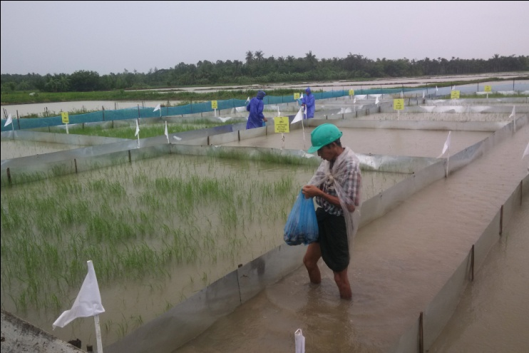
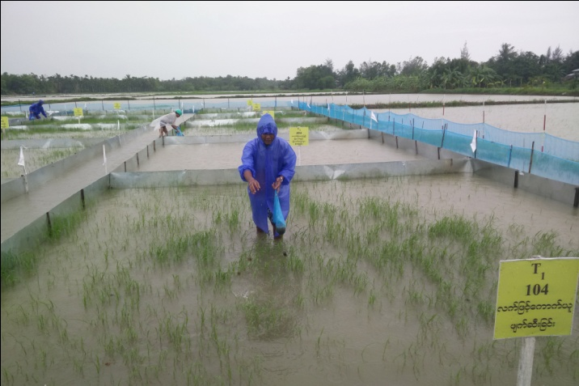
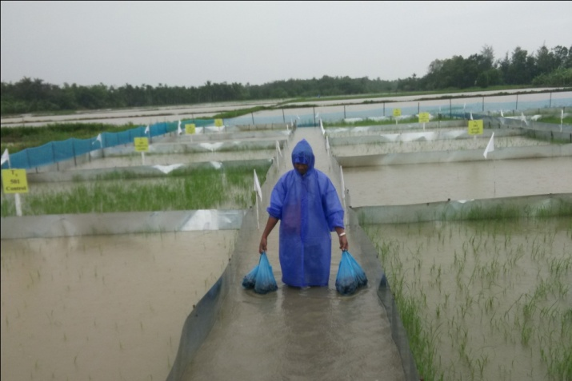
Putting GAS into experimental plot

Slide 9
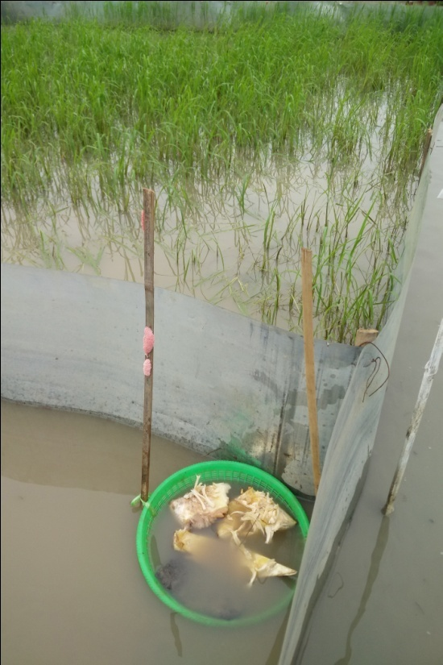
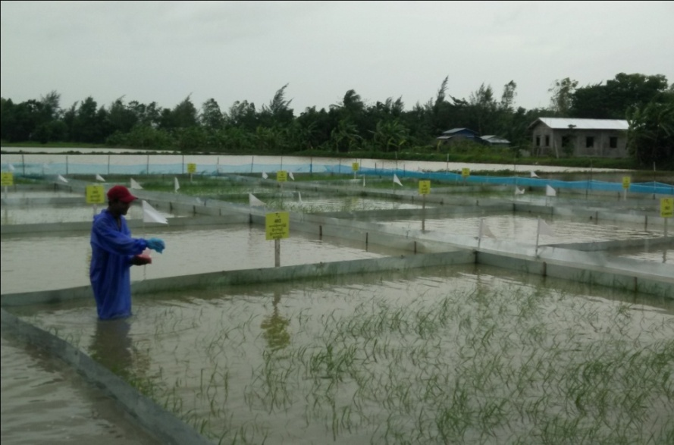
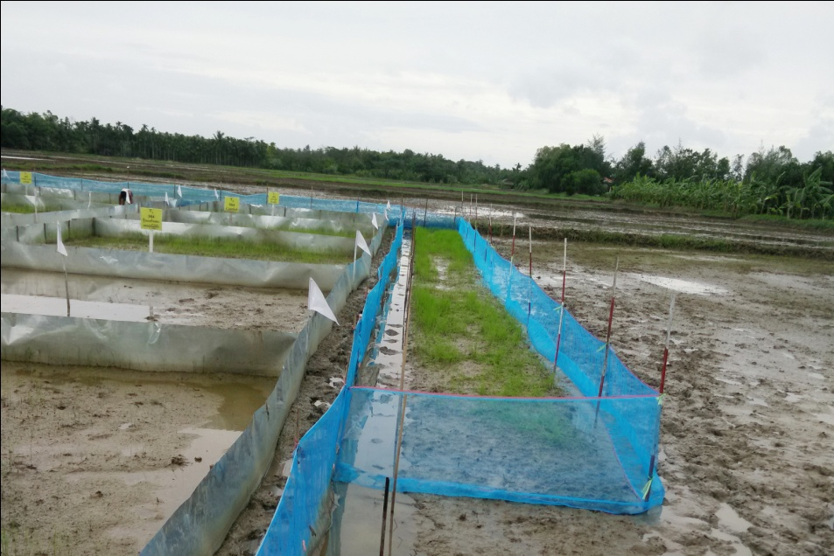
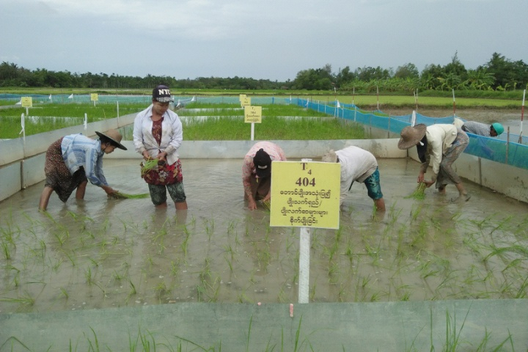
Giving Different Treatments

Slide 10
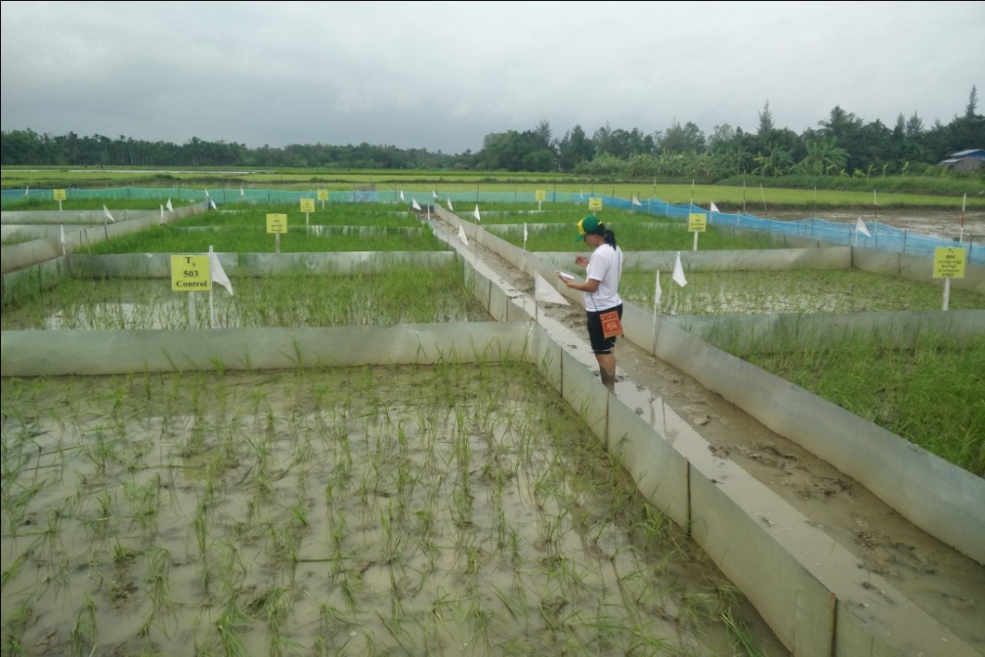
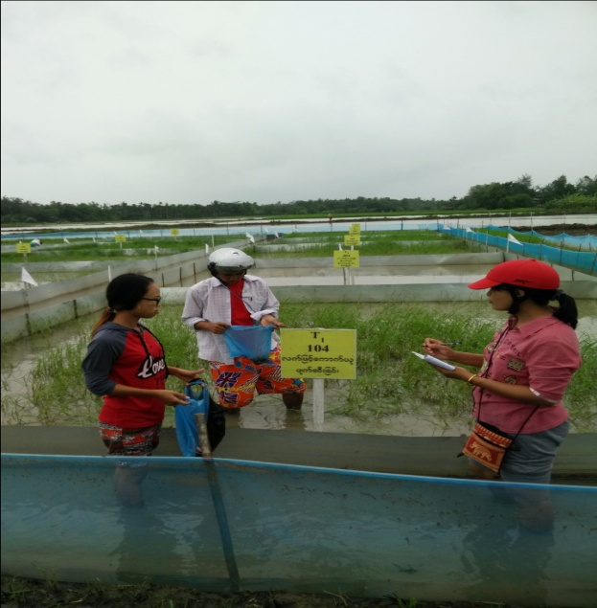
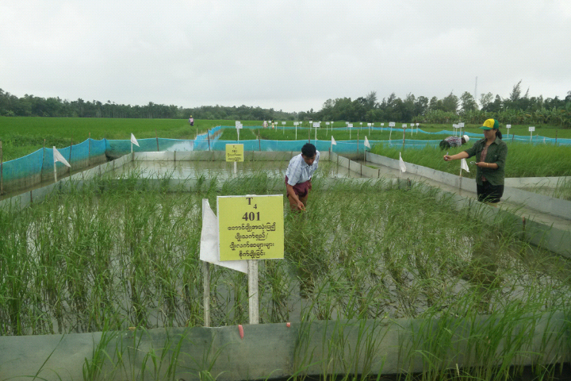
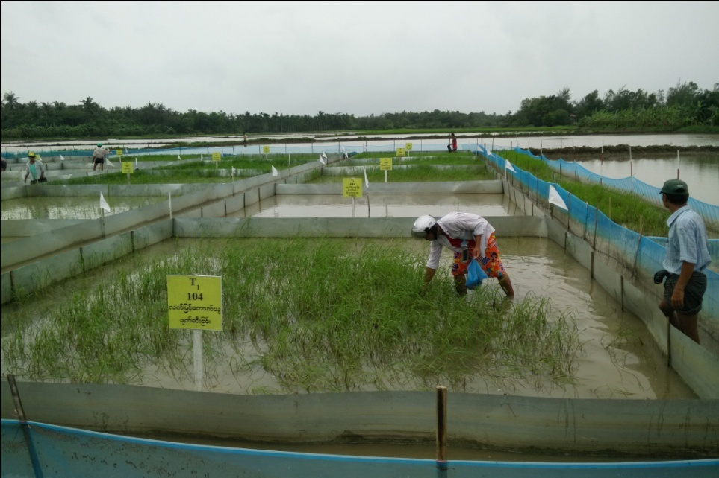
Data Collection

Slide 11
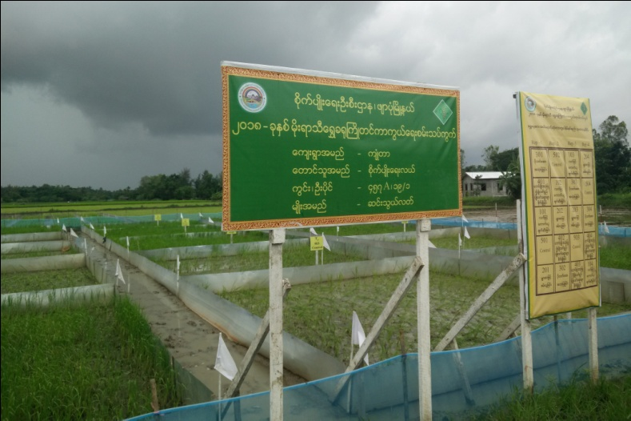
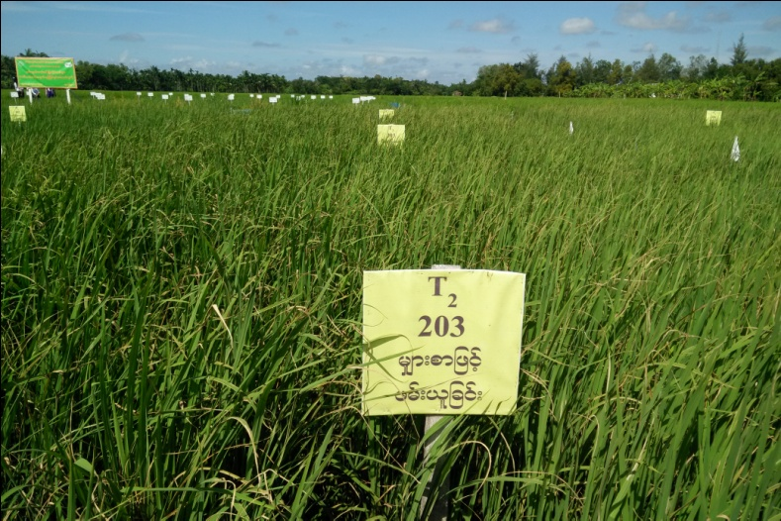
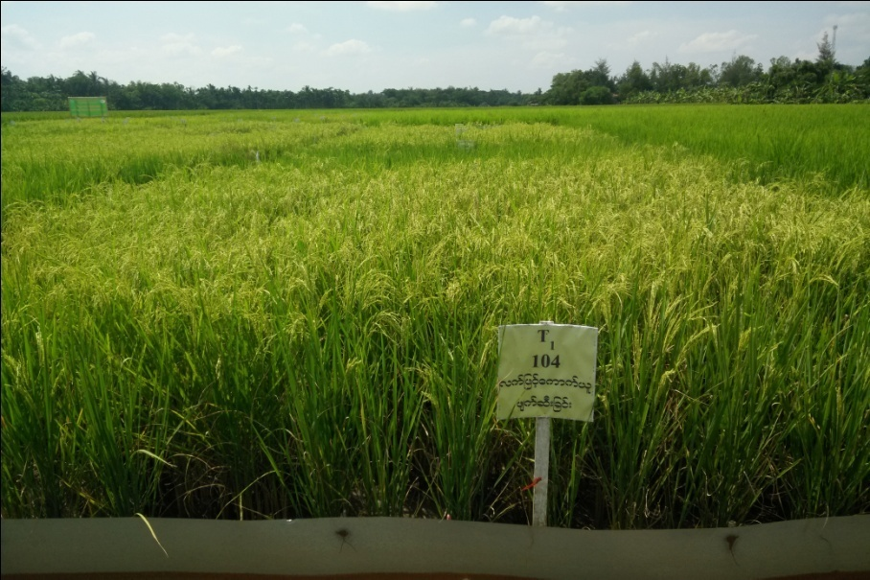
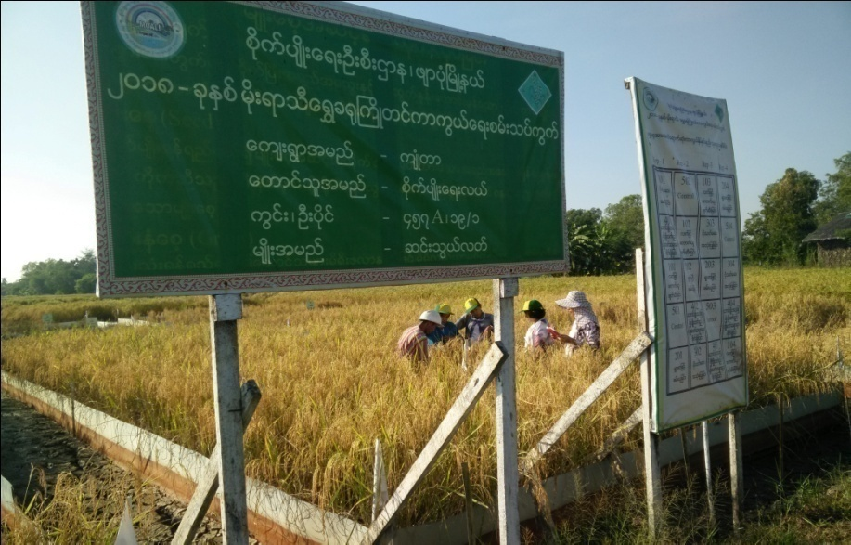
Seasonal Situation of experiment

Slide 12
Experimental Results
 | Treatments | Damage %
 |  | R₁ | R₂ | R₃ | R₄ | Average
T₁ | Hand Picking | 30 | 30 | 15 | 5 | 20
T₂ | Use of attractant feeds | 29 | 35 | 30 | 22 | 29
T₃ | Pesticide Use | 10 | 5 | 5 | 28 | 12
T₄ | Using the raised bed (Old Seedling) | 2 | 1 | 2 | 3 | 2
T₅ | Control | 99 | 90 | 60 | 71 | 80

Slide 13
Experimental Results
No. | Treatments | Yield/Acre(Bsk.)
 |  | R₁ | R₂ | R₃ | R₄ | Average
T₁ | Hand Picking | 57.81 | 54.68 | 68.36 | 76.95 | 64.45
T₂ | Use of attractant feeds | 57.03 | 52.34 | 56.25 | 62.50 | 57.03
T₃ | Use the Pesticide | 71.91 | 76.17 | 74.21 | 58.95 | 70.31
T₄ | Using the raised bed (Old Seedling) | 81.29 | 82.03 | 78.90 | 79.66 | 80.47
T₅ | Controls | 7.2 | 13.67 | 54.68 | 41.01 | 27.34

Slide 14
Discussion
Control
Attractant
Feeds
Hand
Picking
Pesticide
Old Seelding
>
>
>
>
Damage % 80 29 20 12 2
Control
<
Attractant
Feeds
<
Hand
Picking
<
Pesticide
<
Old Seelding
Yeild 27.34 57.03 64.45 70.31 80.47
(Bsk/ac)

Slide 15
Discussion (Hand Picking)
Advantages` | Disadvantages
No effect on environment | labourious
Use of animal feeds | Scarce Labour
Effective for reducing on population | Not suitable for Big Holder farmers
Discussion(Use of Attractant Feeds)
Advantages` | Disadvantages
Overcome the labour shortage | Cannot collect the snails far from attractant feeds
Low labour cost | Difficult for continuously collect and destroy
No effect on environment | Can not completely destroy egg-masses

Slide 16
Discussion (Pesticide Use)
Advantages` | Disadvantages
Reducing the labour cost | High cost of snail-cides
Time Saving | In case of incorrect dosage may harm on any other aquatic animals
Effective for big holder farmers | Hazardous to environment
Discussion (Use of Old seedling)
Advantages` | Disadvantages
Little GAS infestation | More transplanting cost
Higher yield | Being no direct control on GAS which may increase in population in next year

Slide 17
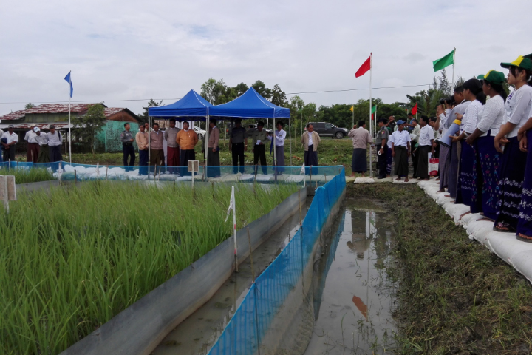
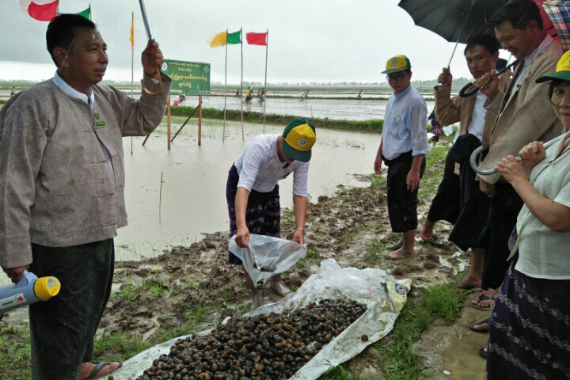
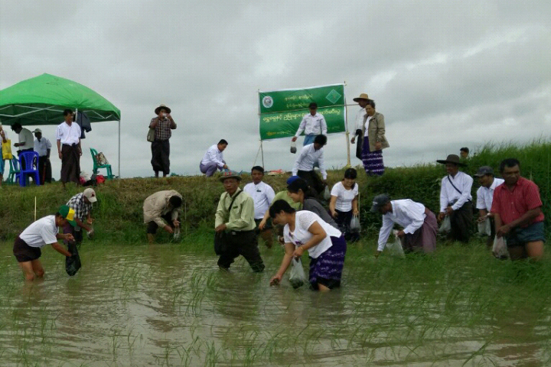
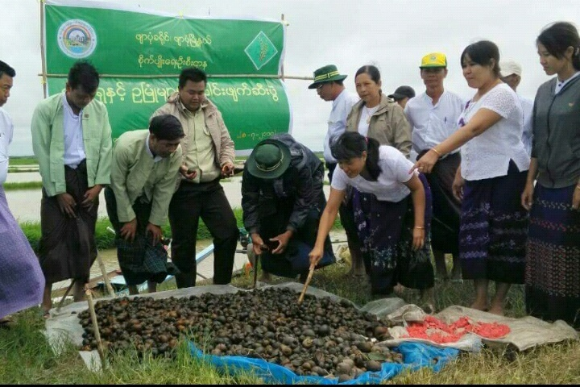
Field Day Of Golden Apple Snail in Pyapon Township

Slide 18
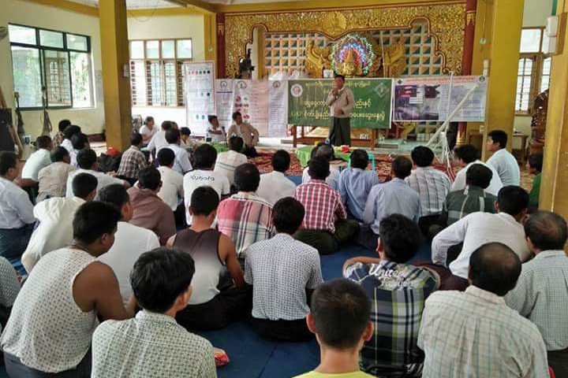
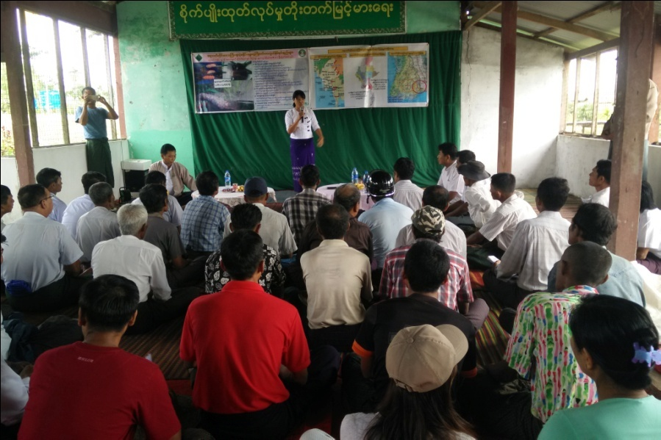
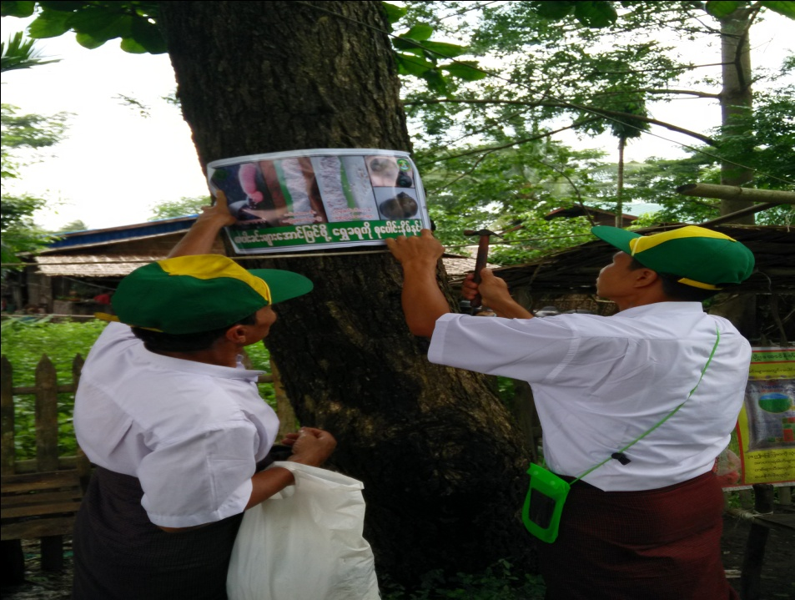
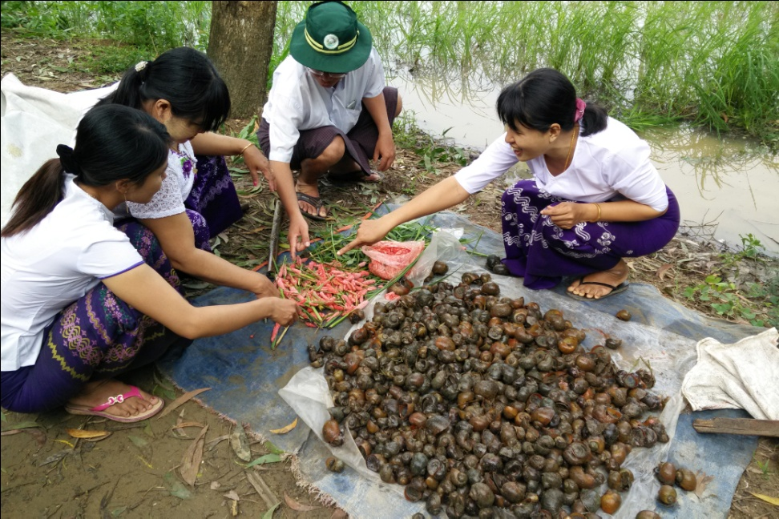
Education and Training on GAS

Slide 19
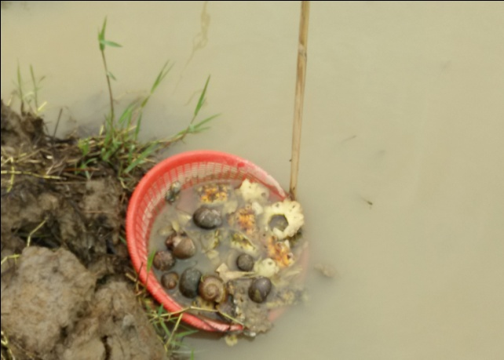
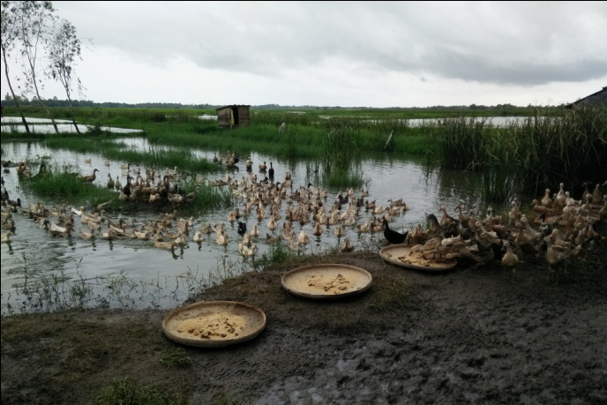
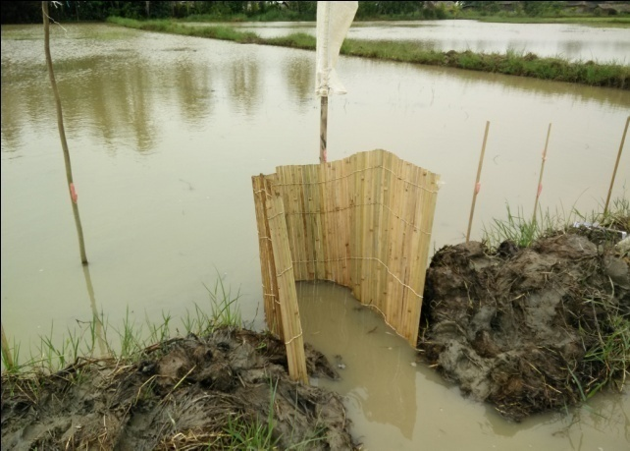
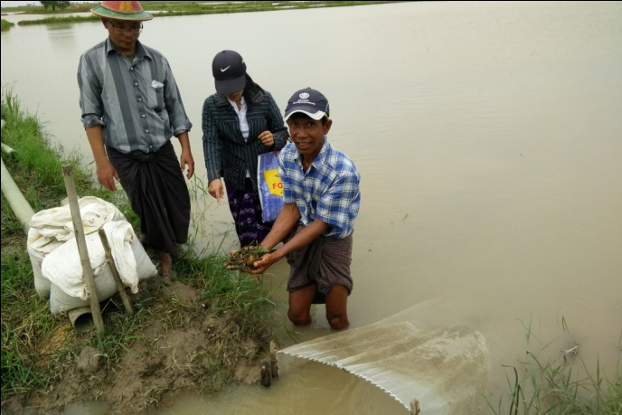
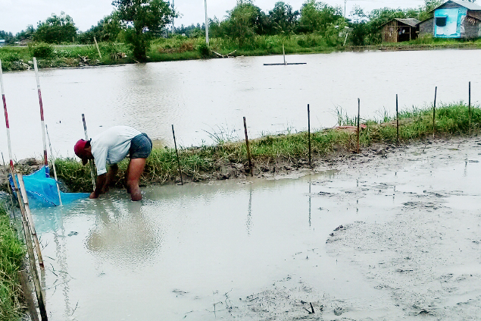
Conclusion And Suggestion
- flooded area, high rainfall with tidal effect
- favourable conditions for GAS outbreak
require good drainage system, raised bund
Awareness of GAS nature and damage systems
-Need to destroy GAS egg- masses
All farmers’ participation is essential through IPM
Should be use of snail- cides in case of under favourable condition
This experiment should be conduct (T1+T2) or (T1 + T4) in next year

Slide 20
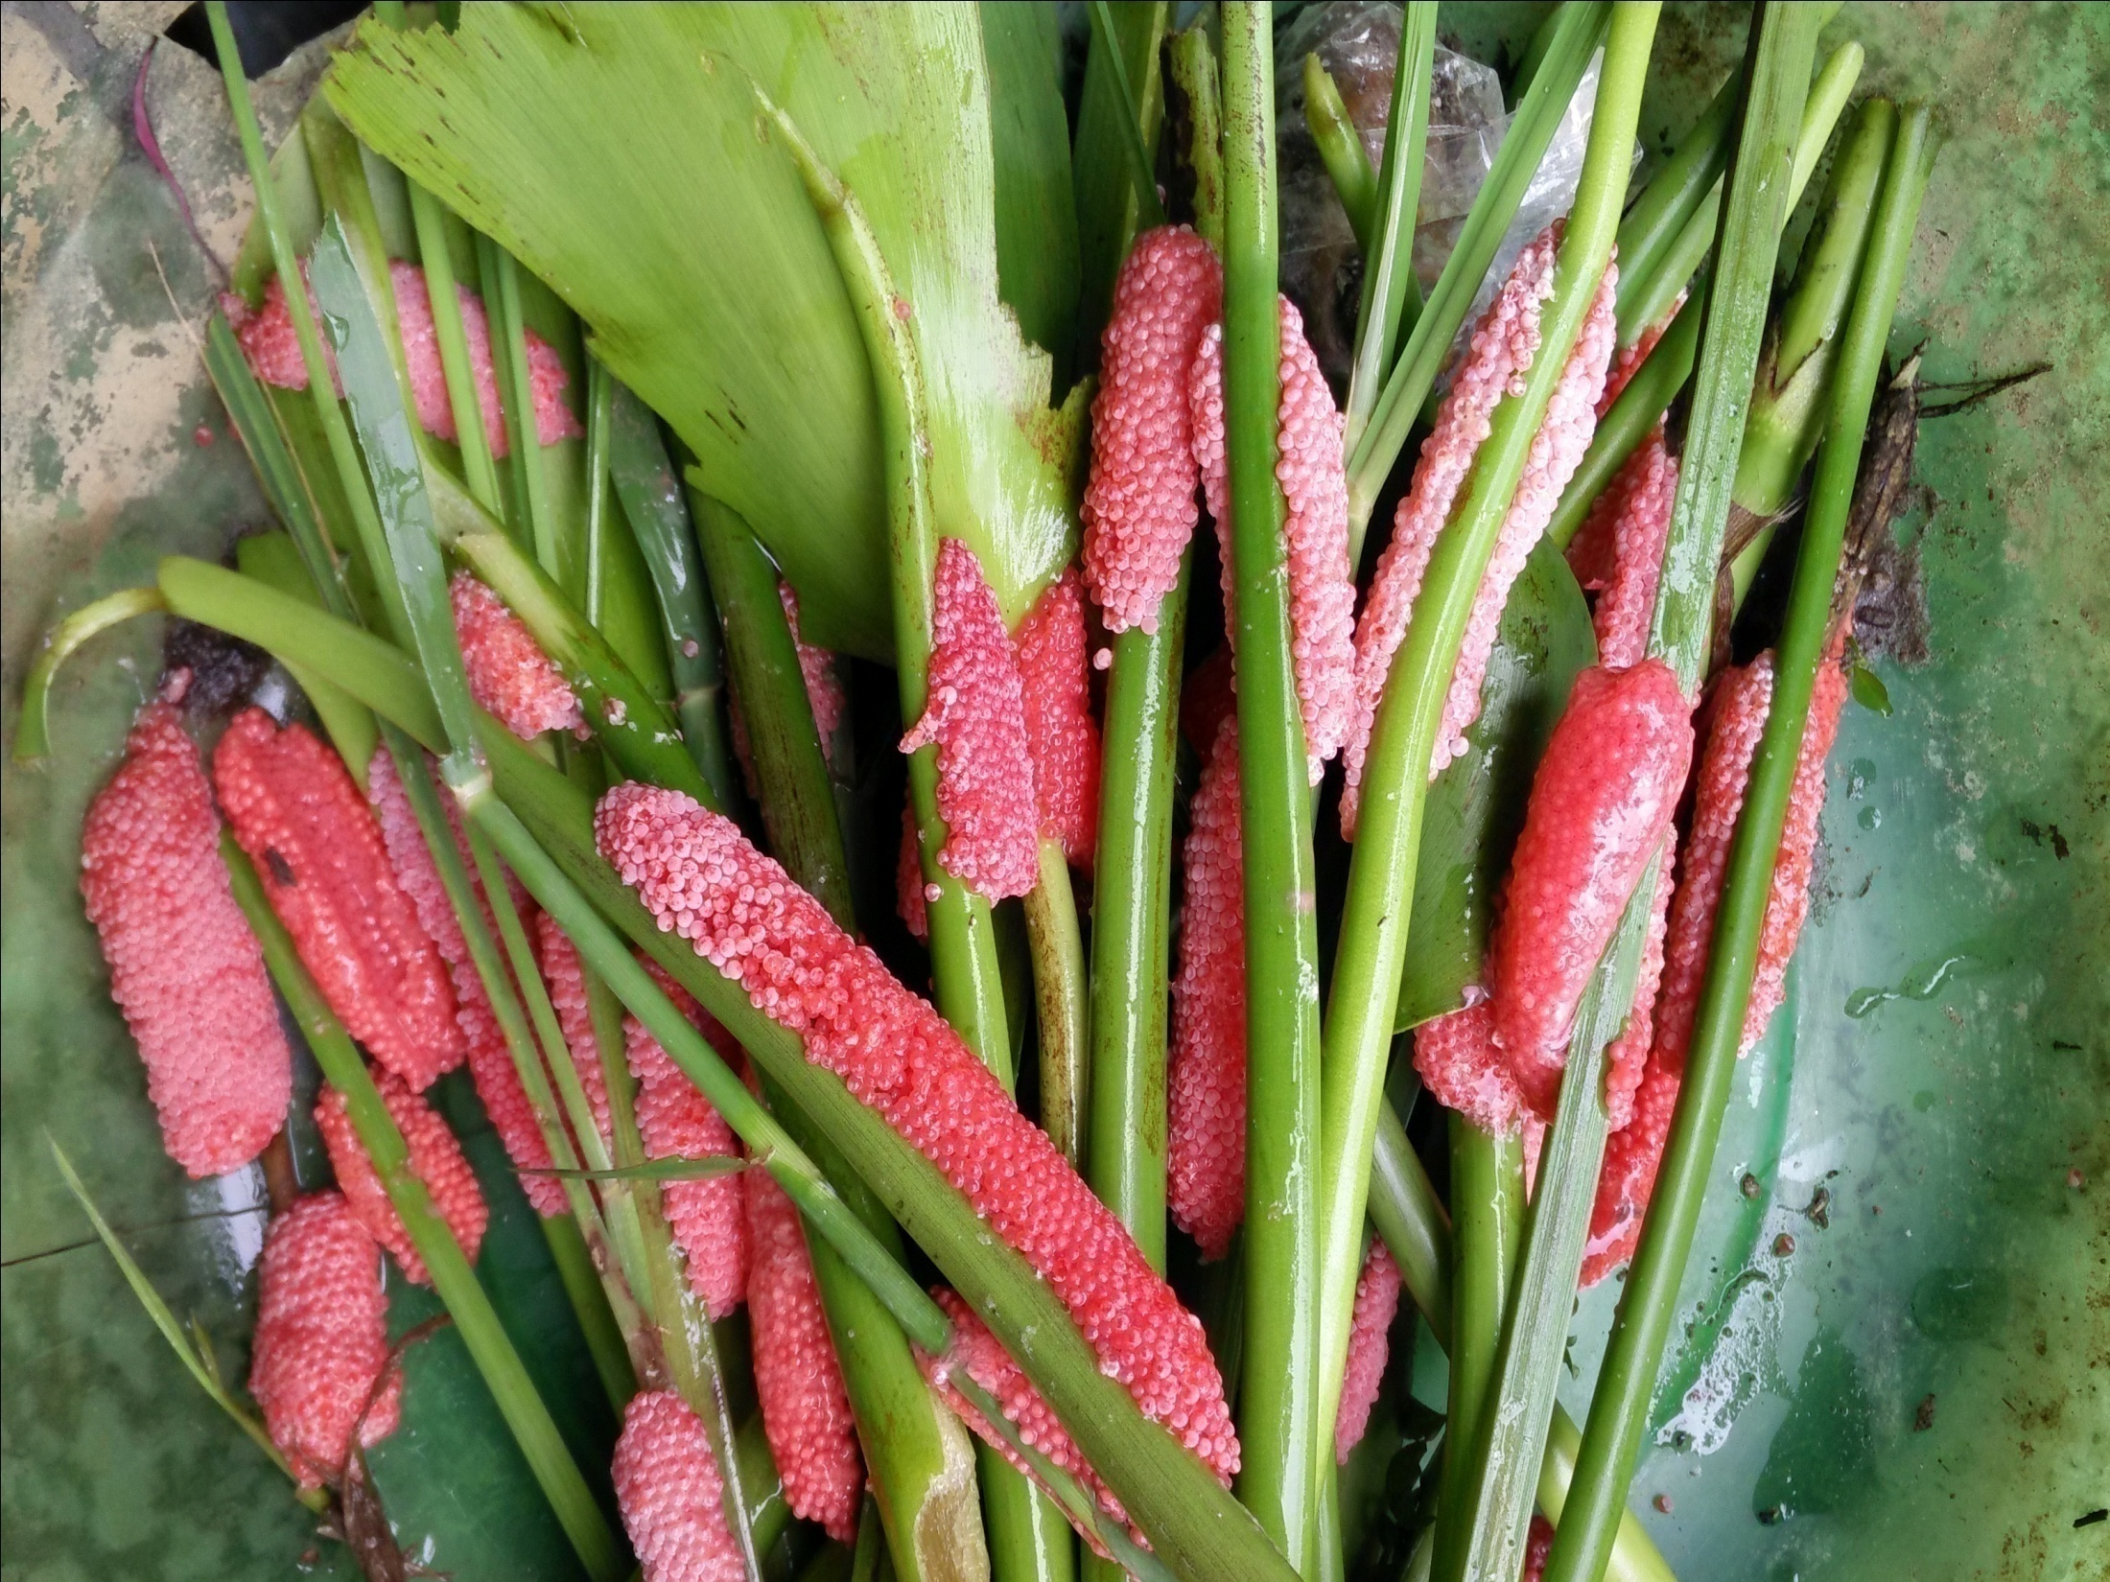
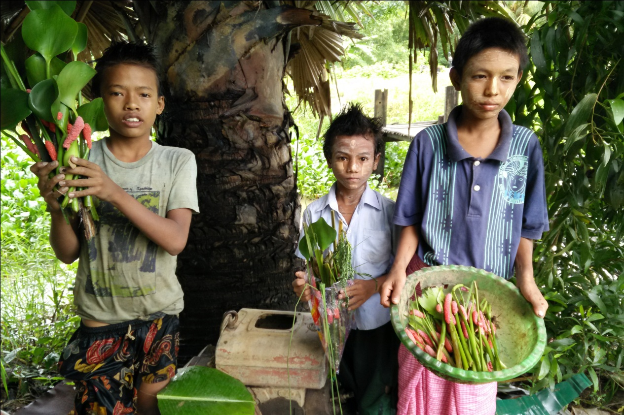
Thank You Very Much

