Slide 1
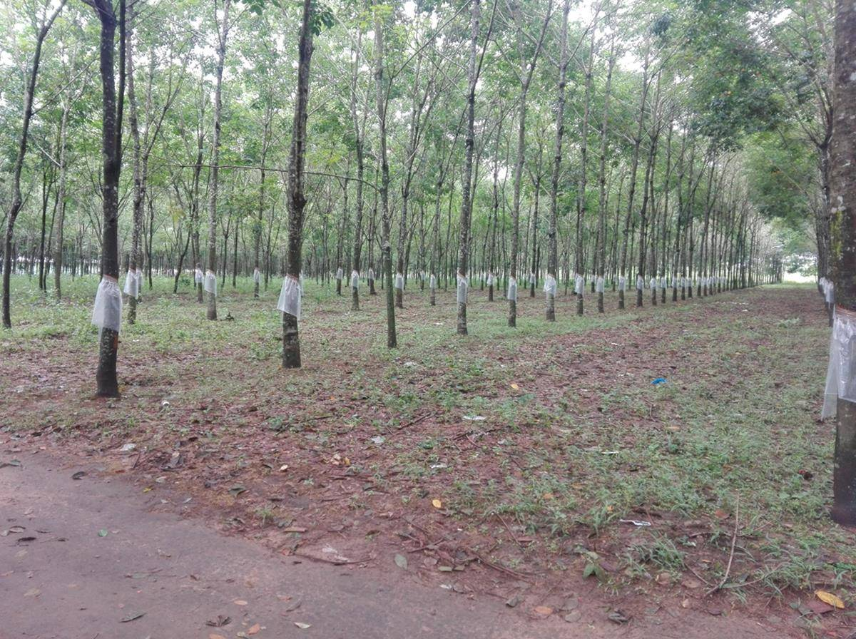


Ministry of Agriculture, Livestock and Irrigation
Department of Agriculture
Effect of rain guarding and tapping systems
on natural rubber production
By
Dr. Aye Thida Win
Dy. Staff Officer
Perennial Crops Research and Development Estate (Mudon)

Slide 2
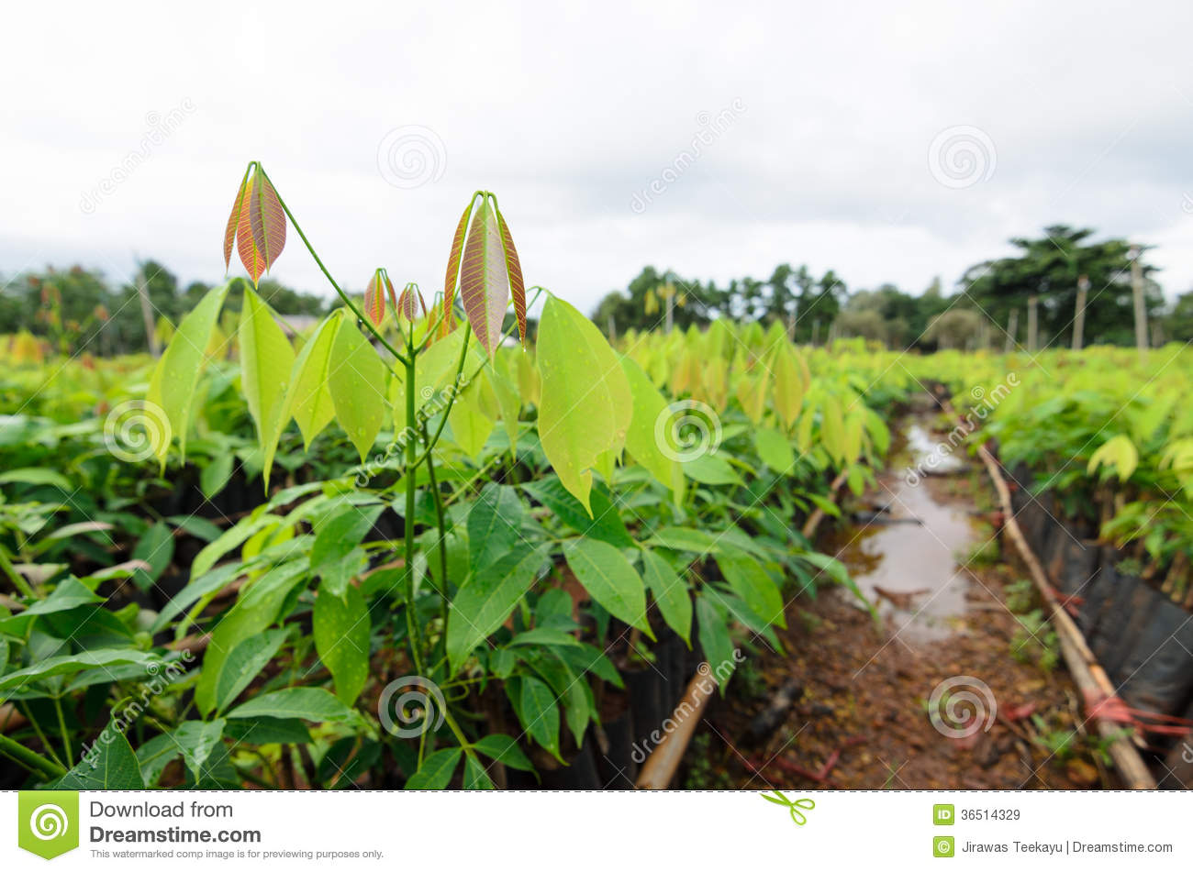
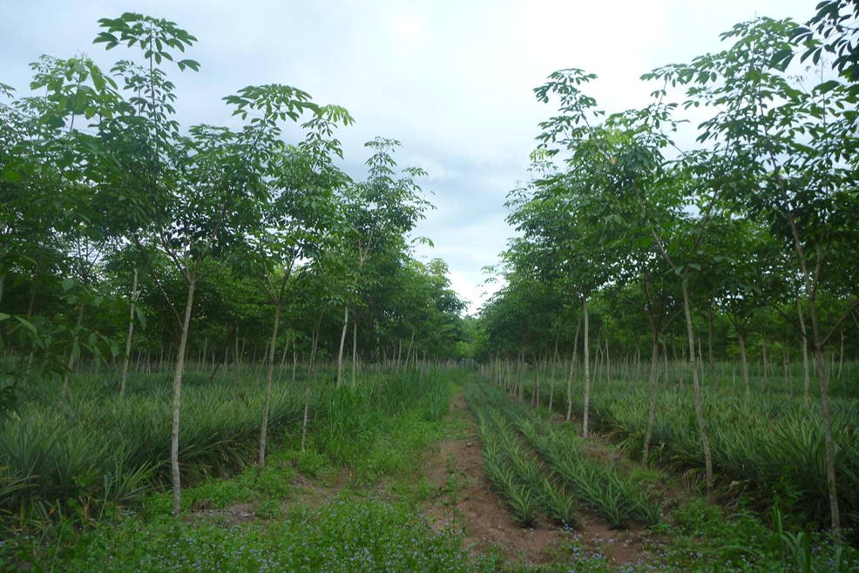
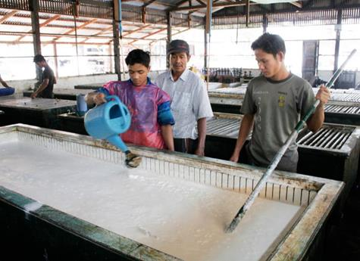
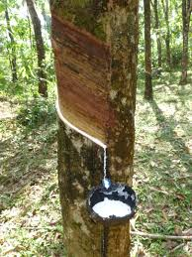
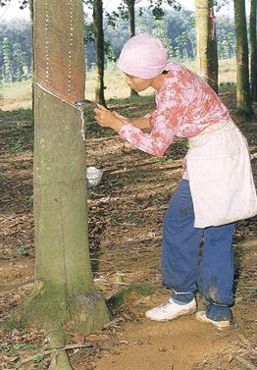
Introduction
Rubber Industry
1. Nursery
2. Immature stage
4. Factory/Processing
3. Tapping
http://www.lgm.gov.my/general/NRHistory.aspx

Slide 3
Introduction
Tapping System
Downward tapping (အောက်ဖက်အစေးခြစ်ခြင်း)
Upward tapping (အထက်ဖက်အစေးခြစ်ခြင်း)
Ladder tapping (လှေကားနှင့်အစေးခြစ်ခြင်း)
Slaughter tapping (အပင်သတ်အစေးခြစ်ခြင်း)
Rainguard tapping (မိုးကာဖြင့်အစေးခြစ်ခြင်း)
Puncher tapping (စူးထိုးအစေးခြစ်ခြင်း)
Tapping Methods
S/2 d/1 (Half Spiral, daily)
S/2 d/2 (Half Spiral, 2 days interval)
S/2 d/3 (Half Spiral, 3 days interval)
S/3 d1 (Third Spiral, daily)
S/3 d/2 (Third Spiral, 2 days interval)
S/3 d/3 (Third Spiral, 3 days interval)

Slide 4
Introduction
Rubber production in Myanmar
Myanmar 2.6%
Myanmar 1.7%
Rest of the World
World share of harvested area
World share of production
Fig. 3. Natural rubber area harvested and production quantity in Myanmar
Source: FAOSTAT

Slide 5
Introduction
Natural rubber yield in Myanmar
yield is increasing
Fig. 4. Natural rubber yield (kg/ha) in Myanmar Source: FAOSTAT

Slide 6
Introduction
Major Constraints of Low Productivity in Myanmar
Lack of certified planting materials
Lack of laws and regulations
Low adoption rate for GAP
Unavailability of skill labors
Application of insufficient amount of chemical fertilizer
Unavailability of high yielding clones
High rainfall reducing tappable days
So on…

Slide 7
Introduction
Average rainfall, raining days in rubber producing countries (30 years)
Countries | Rainfall (mm) | Raining days | Reference
Myanmar | 4331 | 141
Thailand | 1587 | 130 | https://www.tmd.go.th/en/climate.php?FileID=7
India | 2918 | 96 | India Meteorological Department, www.imd.gov.in
China | 1112 | 94 | https://www.travelchinaguide.com/cityguides/yunnan/shangri-la/weather
Higher rainfall and raining days is one of the reasons to reduce tapping days and rubber yield.
Rain guarding can increase tapping days and yield???
S/2 2d3 can increase tapping days and yield???

Slide 8
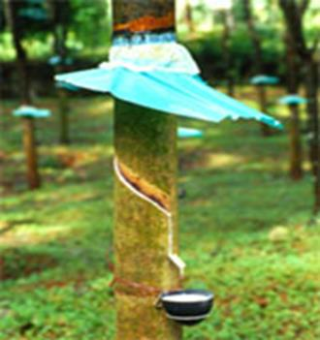
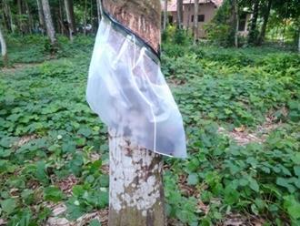
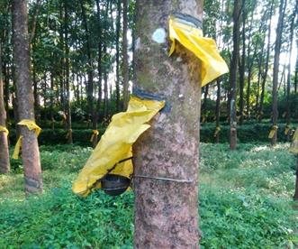
Introduction
1
What is rain guard?
Any suitable device, fixed above the tapping panel to keep the panel, and the collection cup dry during the rainy season.
Different types of rain guarding
Shade type
Polythene skirt type
Modified ready to use skirt type
2
Objectives
To know the effect of rain guarding on rubber production
To examine the effect of tapping system on rubber production
To evaluate the cost and benefit of these systems
3

Slide 9
Materials and Methods
Study site : PCRDE, Mudon, Mon State
Treatments: Main treatment
T1 - No rain guard (Control)
T2 - Rain guard
Sub treatment
F1 – S/2 d2
F2 – S/2 2d3
Design: Split plot on RCB
Replication: 3
Plot size: 44 trees/treat
Data collect: 15 trees/treat
Rubber clone: PB 260
Plant spacing: 22' x 9'
Plant age: 9 years
Total area: 3.5 acres
Measurement parameters
Rubber yield
Bark consumption
Cost and Benefit
Study duration: (7.5 months)
June, 2019 – Jan, 2020

Slide 10
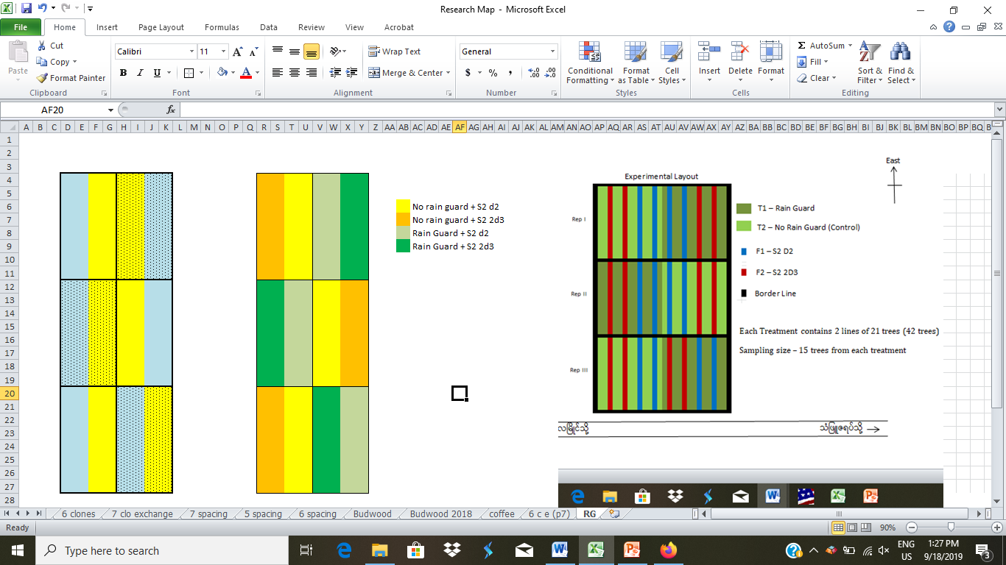
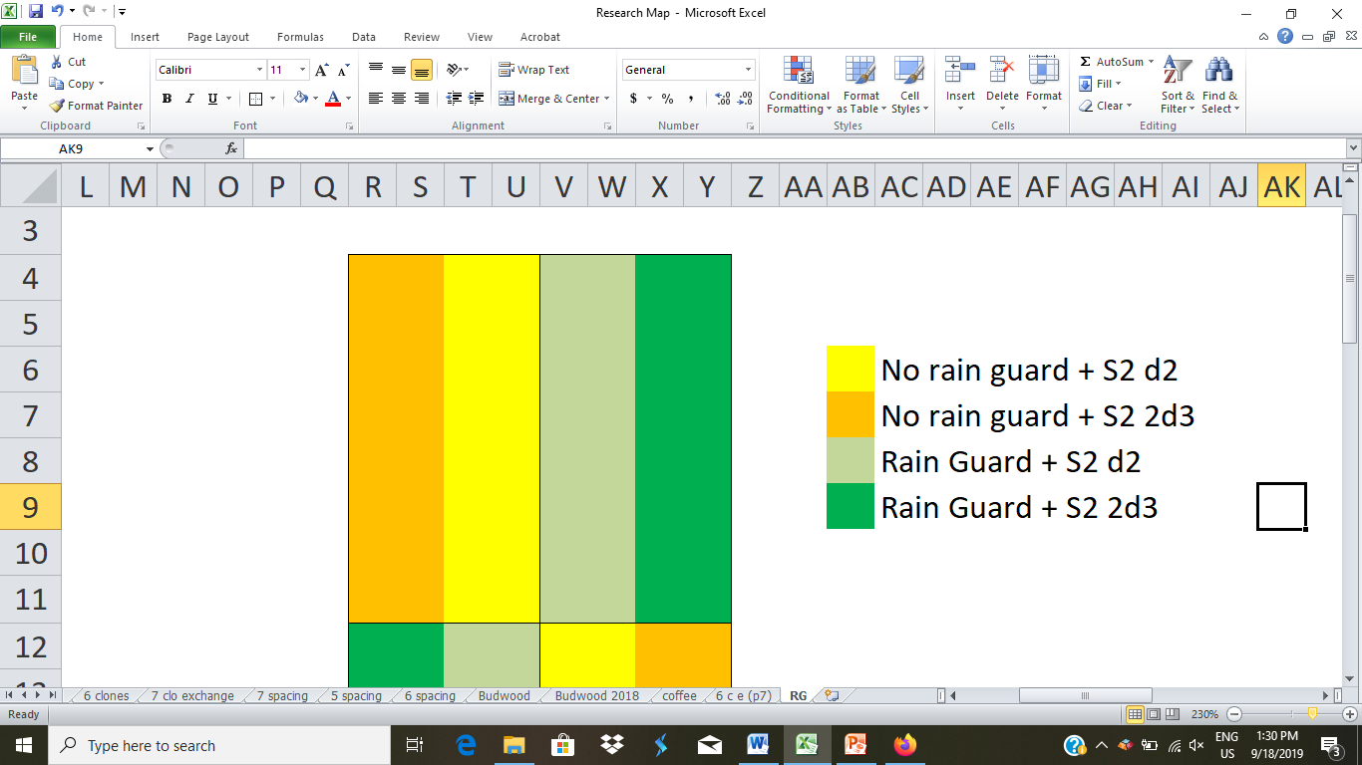
Materials and Methods
Ministry of Agriculture, Livestock and Irrigation
Department of Agriculture
Perennial Crops Research and Development Estate (Mudon)
E
Experimental layout of Rain guarding and tapping systems trial
Rep 1
Experimental site - Plot No. 1
Experimental area - 3.5 acres
Treatment - 4
Replication - 3
Design - Split Plot on RCB
Spacing - 22' x 9'
Plot size - 44 trees
Total plants - 536 trees
Planted year - 2010
Legend
No Rain Guard + S2 d2
No Rain Guard + S2 2d3
Rep 2
Rain Guard + S2 d2
Rain Guard + S2 2d3
Rep 3
To Mawlamyaine

Slide 11
Results and Discussion
Table 1. Total tapping days among the treatments
No Rain guard |  | Rain guard
S/2 d2 | S/2 2d3 | S/2 d2 | S/2 2d3
62 | 81 | 105 | 141
+ 43
+ 60
More tapping days could be obtained by rain guarding and S/2 2d3

Slide 12
Results and Discussion
63%
37%
19%
Fig 6. Total dry rubber yield among the treatments during 7 months period
Higher yield could be obtained by rain guarding and S/2 2d3

Slide 13
Results and Discussion
1.9 times
1.6 times
1.2 times
Fig 7. Bark consumption among the treatments during 7 months period
More tapping days cause higher bark consumption.

Slide 14
Results and Discussion
Fig 8. Cost per unit production among the treatments

Slide 15
Results and Discussion
Cost and Benefit (during 7.5 months)
Fig 9. Cost per unit production among the treatments
Higher cost and income in rain guarding and S/2 2d3

Slide 16
Results and Discussion
Net Profit during 7.5 months period
30.6%
19.3%
7%
Fig 10. Amount of net profit among the treatments
Higher profit in rain guarding and S/2 2d3 system

Slide 17
Results and Discussion
Daily rubber yield (g/t/t) in 2018 and 2019
2018-19
2019-20
Clone PB 260 produces low yield in the 1st year and increase to the next years (Hoong C. W. 1997)

Slide 18
Results and Discussion
Cost and Benefit (last year and this year)
 |  | No Rain guard |  | Rain guard
 |  | S/2 d2 | S/2 2d3 | S/2 d2 | S/2 2d3
Total yield (g/tree) | 2018-19 (one year) | 1644 | 1840 | 1953 | 2361
 | 2019-20 (7.5 months) | 1600 | 1905 | 2185 | 2607
Profit (kyat/ac) | 2018-19 (one year) | 249406 | 251843 | 140471 | 185651
 | 2019-20 (7.5 months) | 343100 | 409156 | 367803 | 448177
Total cost/ unit production (kyat/g) | 2018-19 (one year) | 0.98 | 1.06 | 1.46 | 1.42
 | 2019-20 (7.5 months) | 0.58 | 0.57 | 0.89 | 0.88
Thus, high yielding clone should be used in rain guard tapping.

Slide 19
Conclusion
More tapping days, higher yield and profit can be
obtained by rain guarding.
S/2 2d3 system gives higher yield and profit than S/2 d2 although it caused higher bark consumption.
High yielding clone should be selected to get better profit.
Rain guarding can solve tapper shortage problem.
Future Plan
This trial will be continued until June 2020 (one year round).
may be continued to one more year (until 2020-2021).

Slide 20
Thank you for your kind attention!!!

