Slide 1


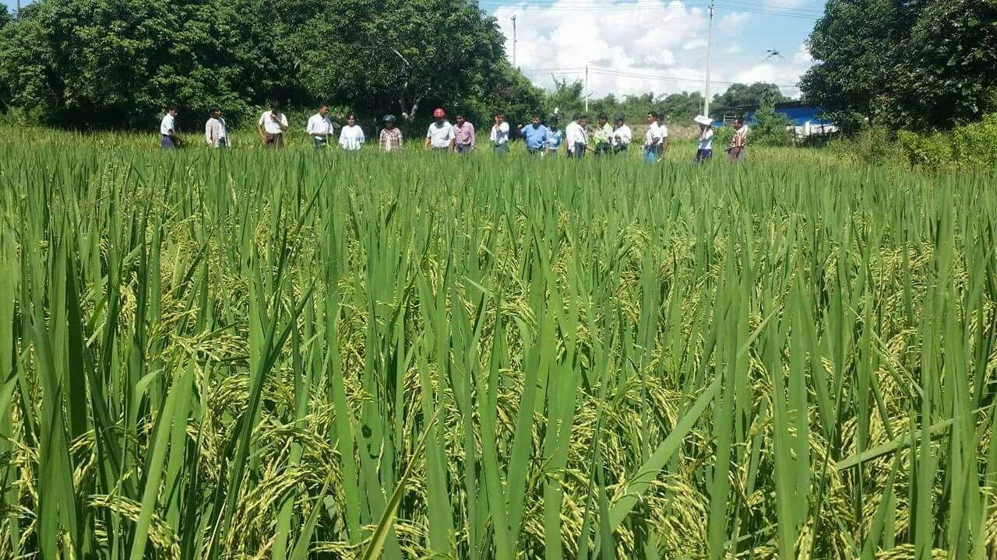
Evaluation of yield and yield Components of Monsoon Rice Grown by
Cultivation Methods
Ministry Of Agriculture , livestock and irrigation
Banmaw Township , Banmaw District
Kachin State .
by
Daw Aye Aye Mya
Assistant Staff Officer
Department of Agriculture (DOA)

Slide 2
Information about Banmaw Township
Area - 759.01 Sq-miles
Sea level - 385 Feet
East - Moemounk
West - Shwegu
South - Mansi
North - Myitkyina, Winemaw
Average rainfall - 70.10 inches / 100 Days
Average temperature - 10 °C - 37 °C
Area of Monsoon Paddy - 19350 ac

Slide 3
INTRODUCTION
Rice is the staple food for Myanmar.
Rice cultivation provide incomes, yield, benefits and employment to millions of house holds for rural farmers.
Direct seeding and transplanting are the most common rice planting techniques in Myanmar.
But, there is poor information on adapted rice growing method and technologies for specific rice growing region including Kachin State.
Need to find the appropriate rice cultivation method in Banmaw township.

Slide 4
OBJECTIVES
To assess yield and yield components of monsoon rice grown by different cultivation methods.
To determine the appropriate planting method for monsoon rice in Banmaw township.
To compare of high yield cultivation method cost and benefit ratio.

Slide 5
ACTIVITIES
Location – U Za Bawgan’s field, 2 miles Aungtha village, Banmaw Township.
period – From June to November, 2017
variety – Sinnakary 3 ( R.S )
Each plots - 0.50 acre
Treatments (four different kinds of cultivation methods)
  (1) SRI (2) BMP (3) Seeder (4) Broadcasting
  Data collection
  Grain yield, yield components were recorded from three sampling
  plots in each cultivation method.

Slide 6
Table 1. Activities of Different Cultivation Methods
No | Content | SRI | BMP | Seeder | Broadcast
1 | Seeding date | 30.6.2017 | 30.6.2017 | - | -
2 | Transplanting date | 12.7.2017 | 16.7.2017 | - | -
3 | Seeding/Broadcast date | - | - | 16.7.2017 | 16.7.2017
4 | Spacing | 10” x 10” | 8” x 6” | 7” x 2”
5 | Plant population | 62000 | 109000 | 144000 | 230000
6 | Harvesting | 9.11.2017 | 9.11.2017 | 16.11.17 | 16.11.17

Slide 7
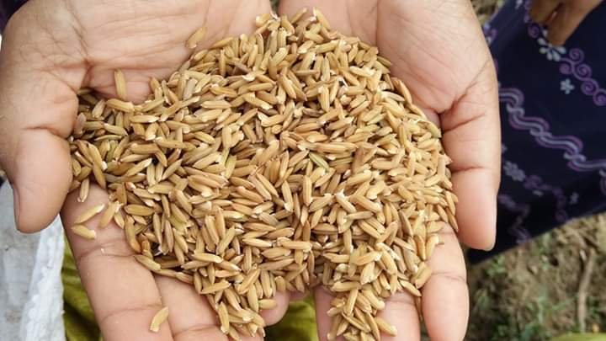
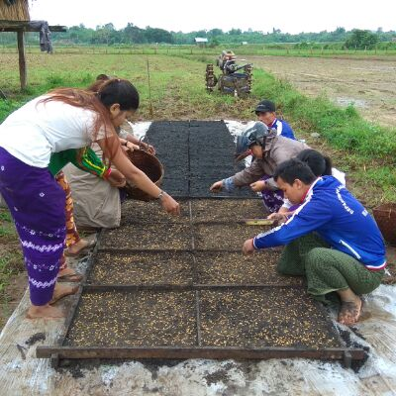
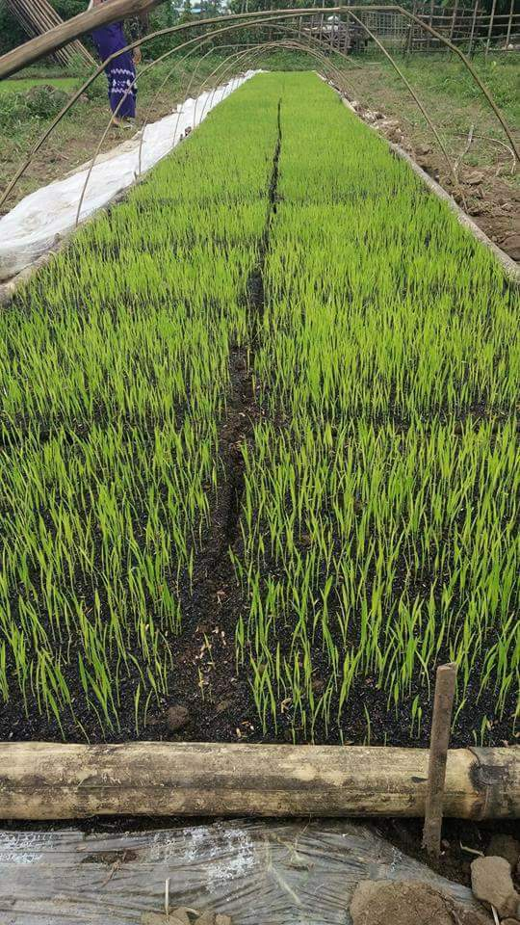
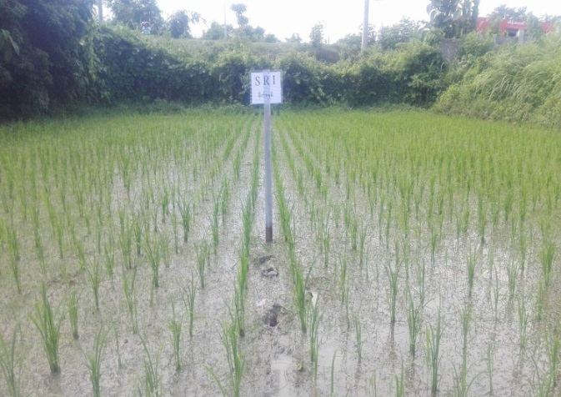
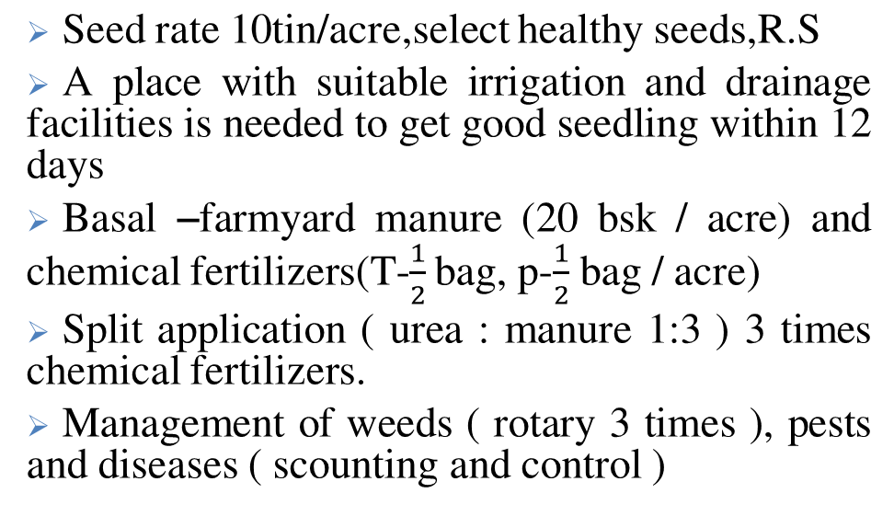
Treatment 1. System of Rice Intensification (SRI)
germination
Seedbed preparation
nursery management
Seed rate 10tin/acre,select healthy seeds,R.S
A place with suitable irrigation and drainage facilities is needed to get good seedling within 12 days
Basal –farmyard manure (20 bsk/ acre) and chemical fertilizers(T-$\frac{1}{2}$ bag, p-$\frac{1}{2}$ bag / acre)
Split application ( urea : manure 1:3 ) 3 times chemical fertilizers.
Management of weeds ( rotary 3 times ), pests and diseases ( scounting and control )
Transplanted Field

Slide 8
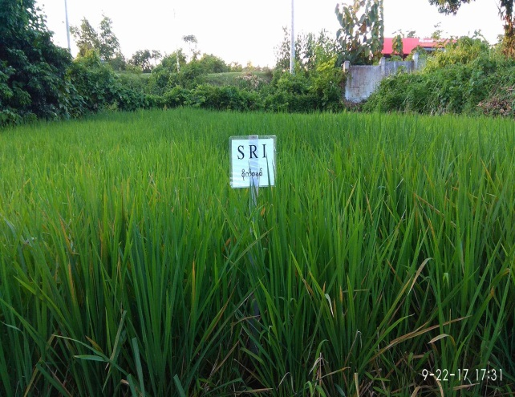
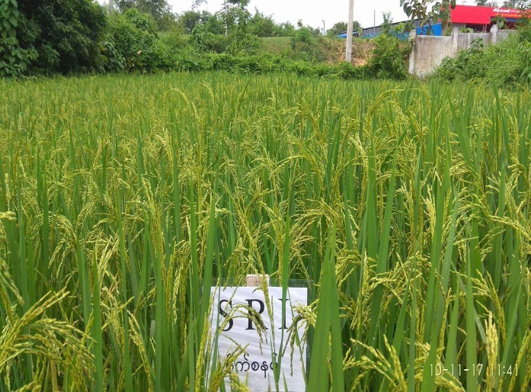
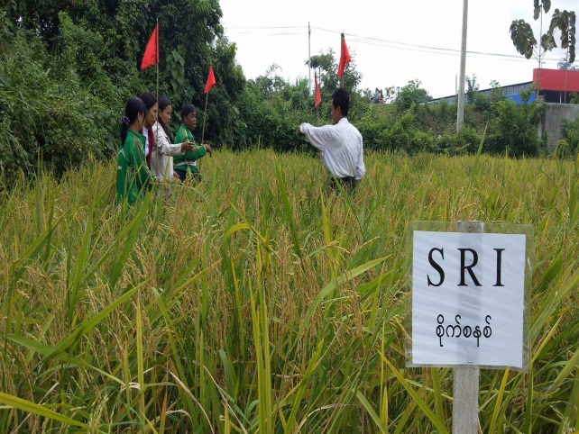
SRI rice field
Before harvest (95-110 DAT)
Yield sampling (SRI)

Slide 9
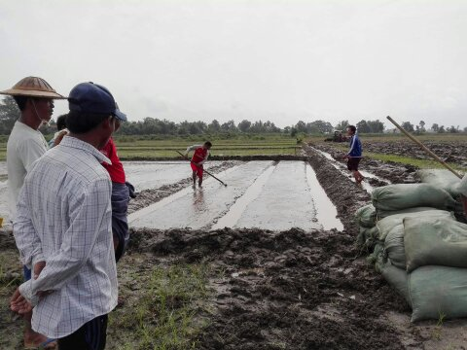
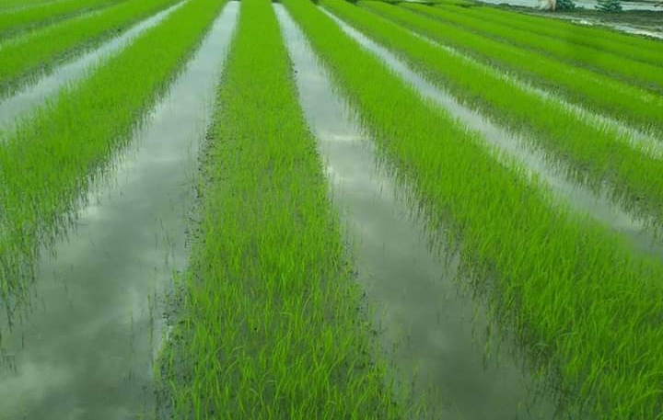
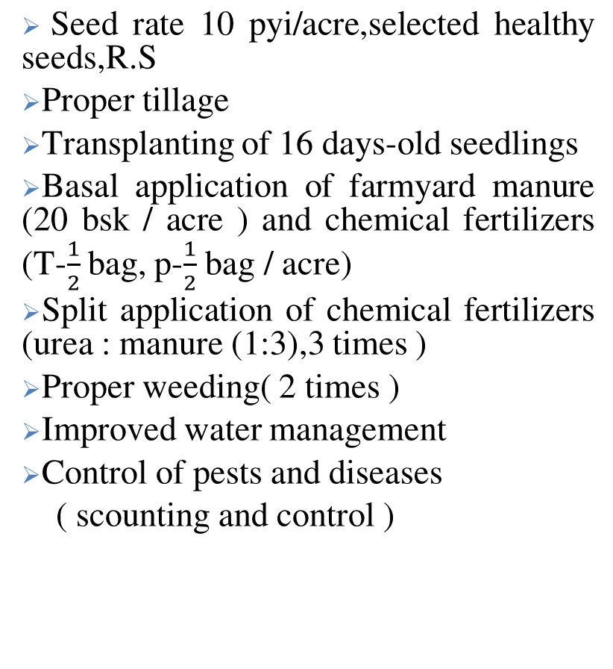
Treatment 2. Best Management Practice ( BMP)
Seed rate 10 pyi/acre,selected healthy seeds,R.S
Proper tillage
Transplanting of 16 days-old seedlings
Basal application of farmyard manure (20 bsk/ acre ) and chemical fertilizers (T-$\frac{1}{2}$ bag, p-$\frac{1}{2}$ bag /acre)
Split application of chemical fertilizers (urea : manure (1:3),3 times )
Proper weeding( 2 times )
Improved water management
Control of pests and diseases
( scounting and control )
Seedbed preparation
Nursery

Slide 10
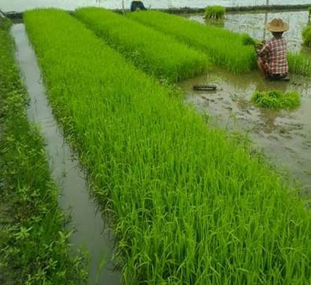
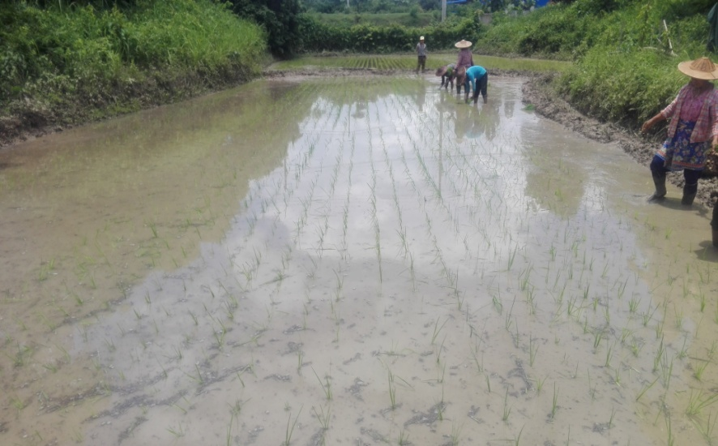
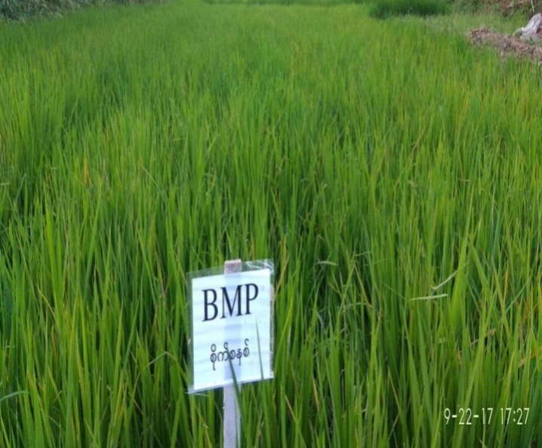
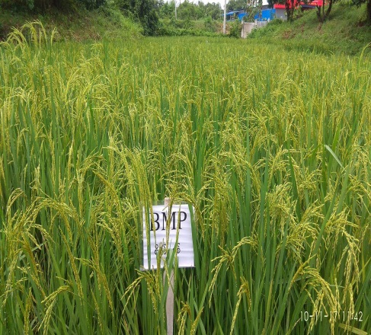
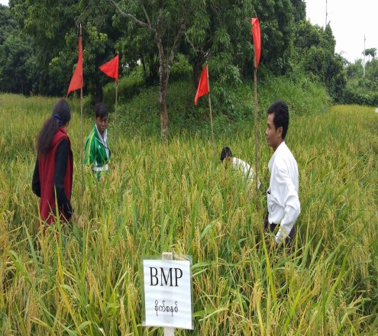
2. Best Management Practice (BMP)
uprooting the seedlings
Transplanting 16 days-old seedlings
BMP rice field
Before harvest
Yield Sampling

Slide 11
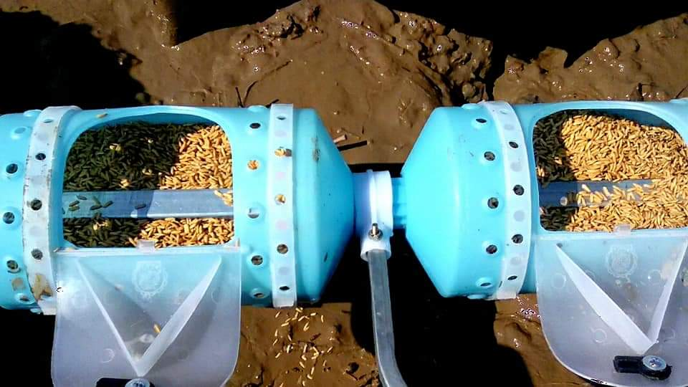
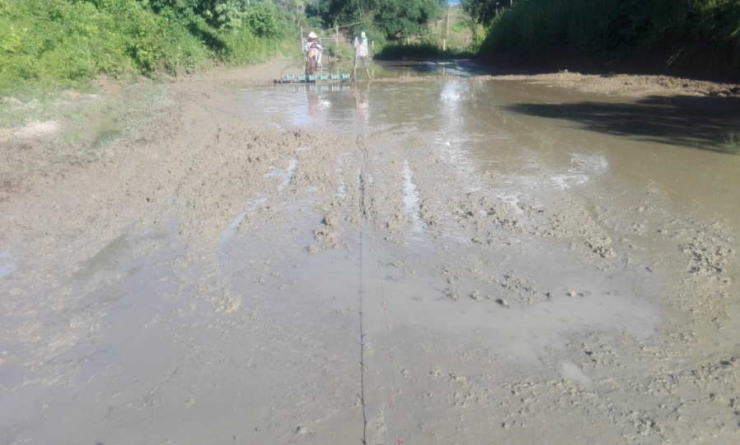
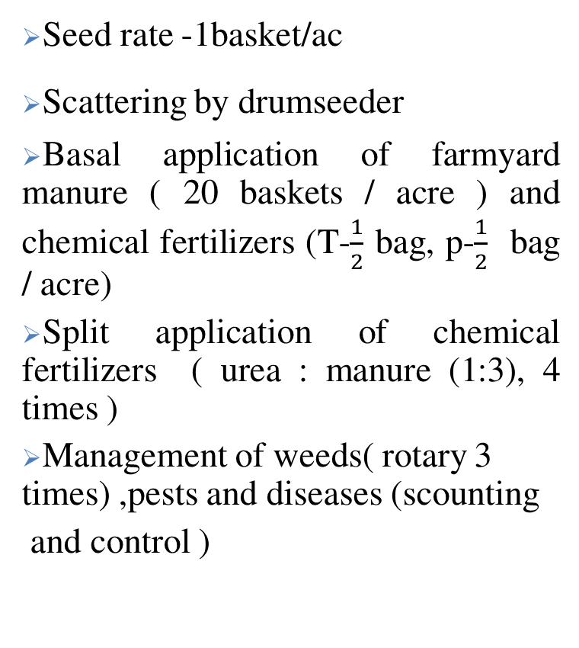
Treatment 3. Seeder Method
Seed rate -1basket/ac
Scattering by drumseeder
Basal application of farmyard manure ( 20 baskets / acre ) and chemical fertilizers (T-$\frac{1}{2}$ bag, p-$\frac{1}{2}$ bag /acre)
Split application of chemical fertilizers ( urea : manure (1:3), 4 times )
Management of weeds( rotary 3 times) ,pests and diseases (scounting
and control )

Slide 12
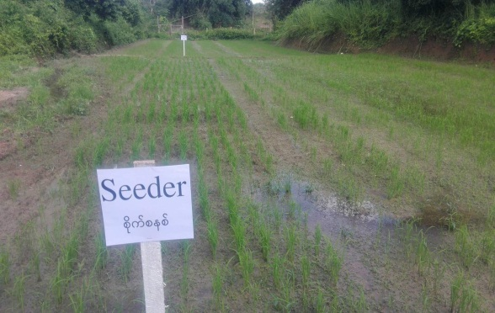
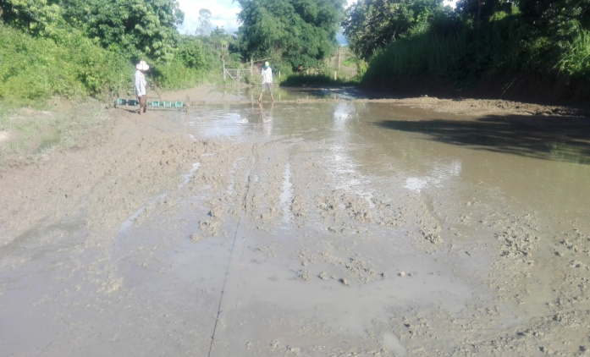
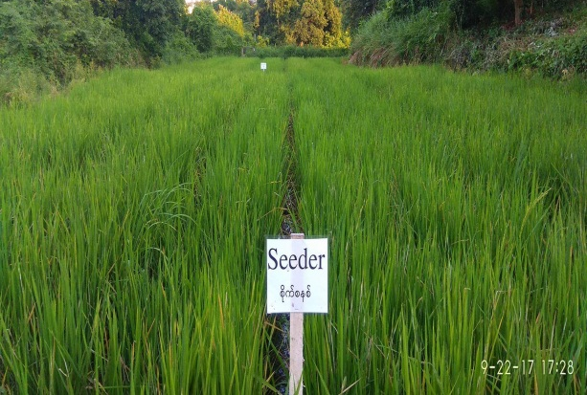
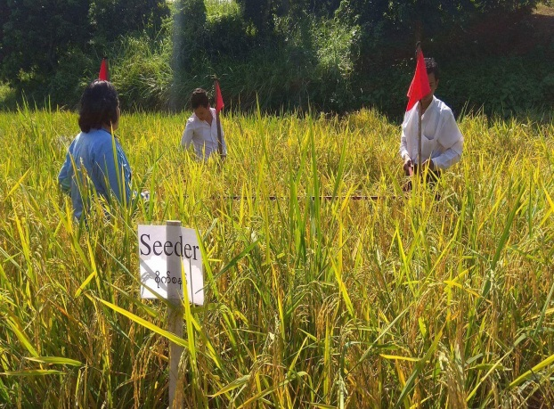
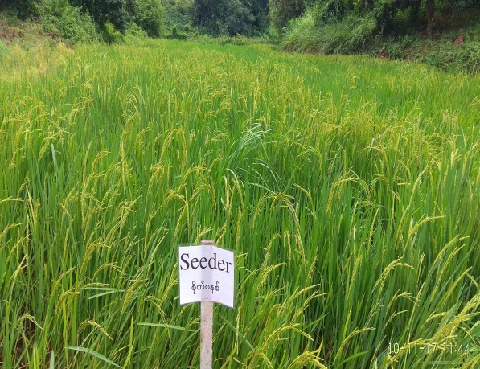
3. Seeder Method

Slide 13
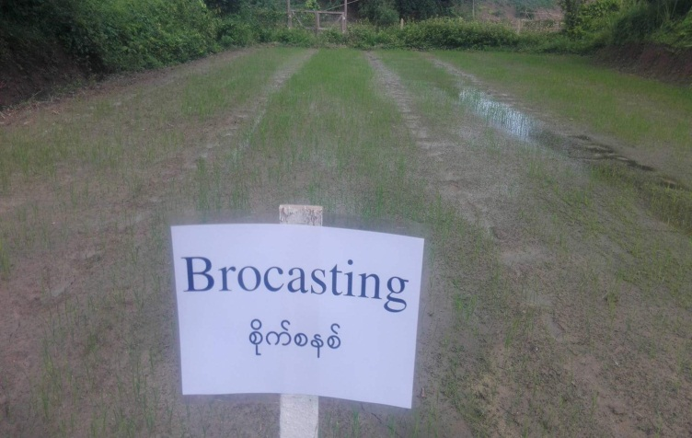
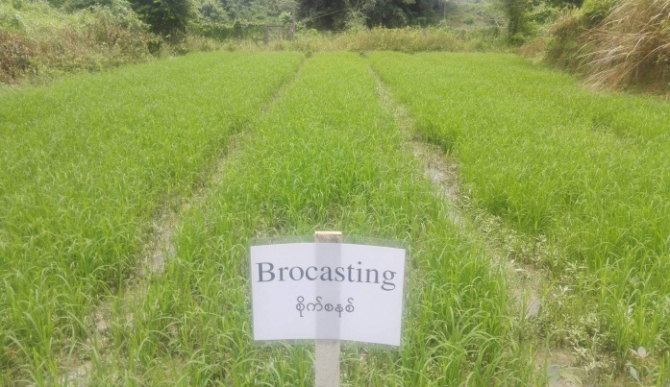
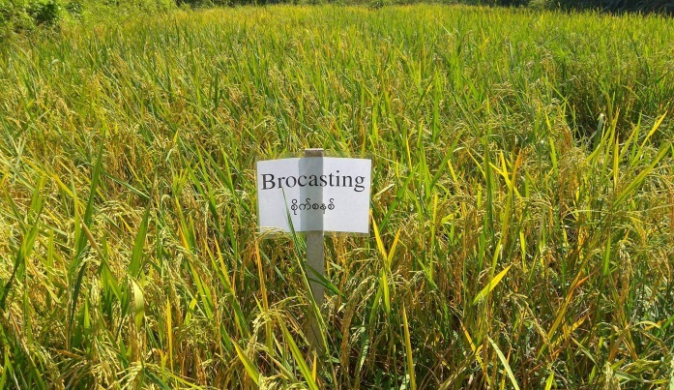

Treatment 4. Broadcasting Method
Seed rate 1.5 baskets/ac
Scattering the seeds
Basal application of farmyard manure (20 baskets / acre )and chemical fertilizers (T-$\frac{1}{2}$ bag, p-$\frac{1}{2}$ bag /acre)
Split application of chemical fertilizers ( urea : manure (1:3), 4 times )
Management of weeds(herbicide 3 times) , pests and diseases ( scounting and control )

Slide 14
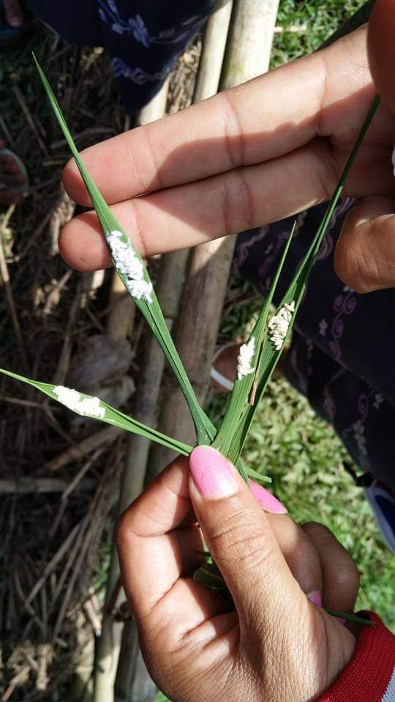
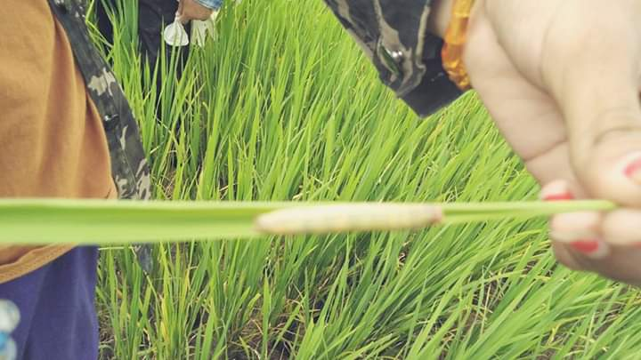
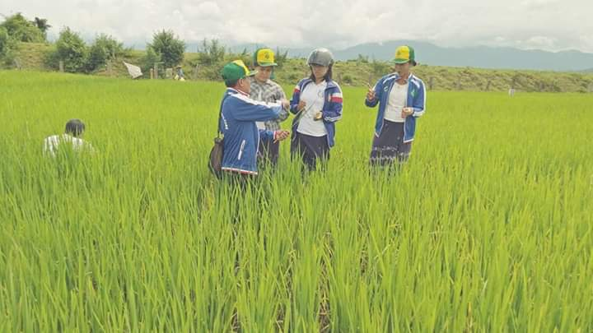
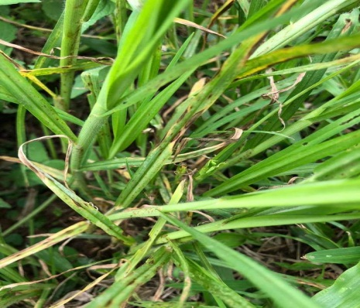
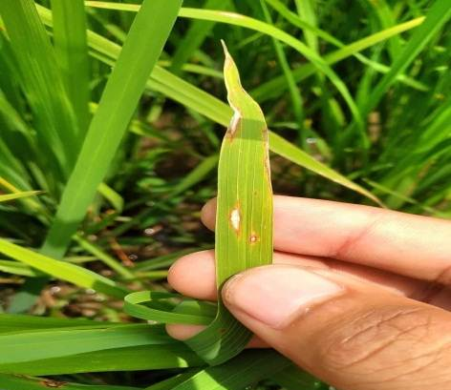
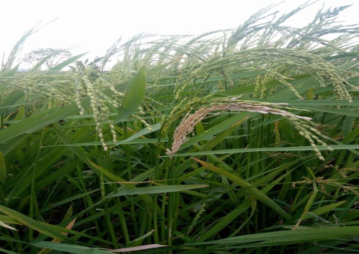
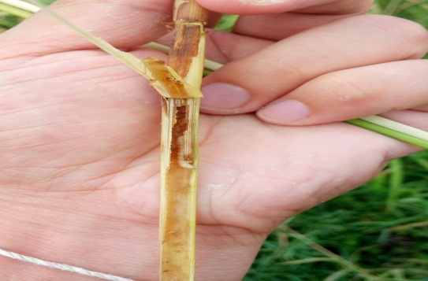
Field Inspection
Parasitoid cocoons
Rice skipper
Leaf Blast symptom
White head and stem borer larva

Slide 15
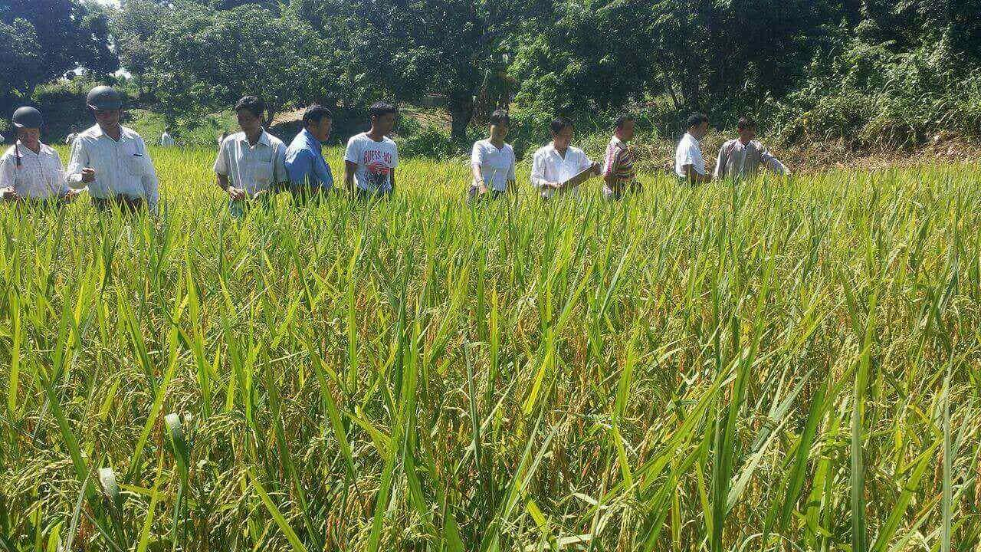
Field day

Slide 16
Yield and yield components of rice grown by different planting methods ( data collection )
RESULTS
Sr. | Parameter | Planting Method
 |  | SRI | BMP | Seeder | Broadcast
1 | 50% Flowering stage (days) | 105 DAS | 106 DAS | 95 DAS | 95 DAS
2 | No. of panicles per hill | 13 | 12 | 7 | 4
3 | No. of grains per panicle | 119 | 77 | 77 | 73
4 | Filled grains percent | 84.93 | 84.41 | 76.60 | 83.30
5 | 1000 grain weight (g) | 27.9 | 27.9 | 26.8 | 25.7
6 | Grain yield (bsk/ac) | 108.83 | 113.00 | 76.30 | 68.85
* DAS – days after sowing

Slide 17
Fig 2. Grain yield of monsoon rice grown by four cultivation methods

Slide 18
DISCUSSION
More tillers and better root growth in SRI and BMP methods.
High filled grain percentage and high 1000 grain weight.
The highest grain yield (113 bsk/ac) from BMP and second highest yield (108.83 bsk/ac) from SRI.
Low grain yield (76.30 bsk/ac) from seeder method
The lowest grain yield (68.85 bsk/ac) from broadcasting method.
Broadcasting method (more infected of pests and diseases).

Slide 19
CONCLUSION AND SUGGESTION
The highest grain yield from BMP and the lowest yield from broadcasting method.
SRI,BMP and Seeder - Easier for weeds, pests and diseases control and nutrient management but more labours and intensive care are needed.
Most rural farmers prefer seeder method (less labour needed).
Convince more farmers in Banmaw, adopted high yielding cultivation methods such as BMP and SRI.
Need to take into account of cost and benefit ratio.

Slide 20
THANK YOU

